Slide 1


Slide 2


HOUSEKEEPING ITEMS
While we wait…
Please MUTE your computers and/or cellphones
Press *6 to unmute (if asked to speak)
Please CHANGE your screen name
Use ‘Your Name (Company Name (or Initials))
    EXAMPLE: James B (PBC)
Please ADD your name to Chat
Use ‘Your Name|Company Name (or Initials)’
    EXAMPLE: James Borkman (PBC)
Please WAIT for Q&A to ask questions
Q&A session will be at the end of each meeting
Feel free to use the ‘Chat’ feature

Slide 3
Works Progress Administration (“WPA”) Streets Reconstruction Medill Avenue
C1603
Pre-Bid and Technical Review Meeting
September 14, 2022 at 10:00am

Slide 4
AGENDA
Introductions
Procurement Details
Compliance
Technical Review
Q&A

Slide 5
Introductions

Slide 6
INTRO
PBC
CDOT
General Contractors
Sub-Contractors/Suppliers

Slide 7
Procurement Details

Slide 8
Procurement Details
PROJECT OVERVIEW
Project Location
WEST MEDILL AVENUE FROM NORTH OAK PARK AVENUE TO NORTH NORMANDY AVENUE - Chicago, Illinois
General Scope of Work
Full depth pavement reconstruction
Special excavation
Portland Cement concrete Base course
Hot-Mix Asphalt Surface course
Sewer and Drainage Structures
Concrete Curb, Gutter, Sidewalks, Driveways and Alleys
Pavement markings
Associated Site Development

Slide 9
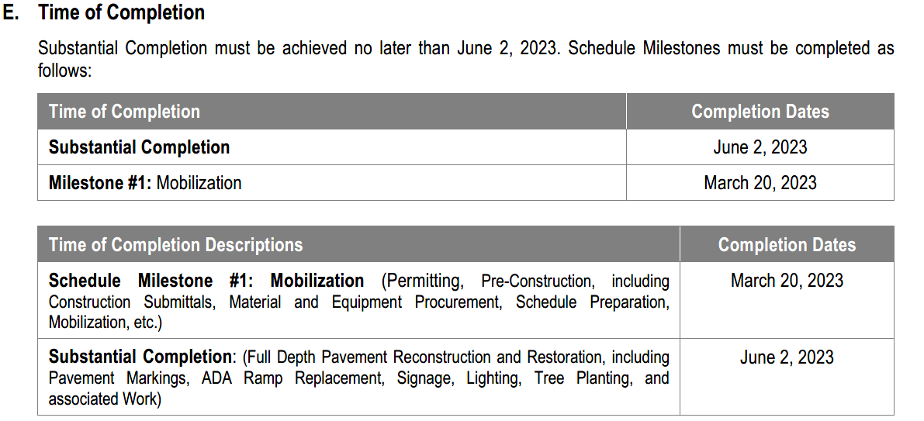
Procurement Details
PROJECT OVERVIEW
Time of Completion
Liquidated Damages
$1,000.00 per day – For failure to achieve Substantial Completion
$500 per day - For failure to achieve milestone date(s)

Slide 10
Procurement Details
AVAILABILITY OF DOCUMENTS
Online Planroom
Cushing and Company Planroom
Printer Contact Information
Cushing and Company
213 West Insitute Place, Suite 200
Chicago, Illinois 60610
Contact Name: Jorge Galvan
Telephone Number: 312-266-8228

Slide 11
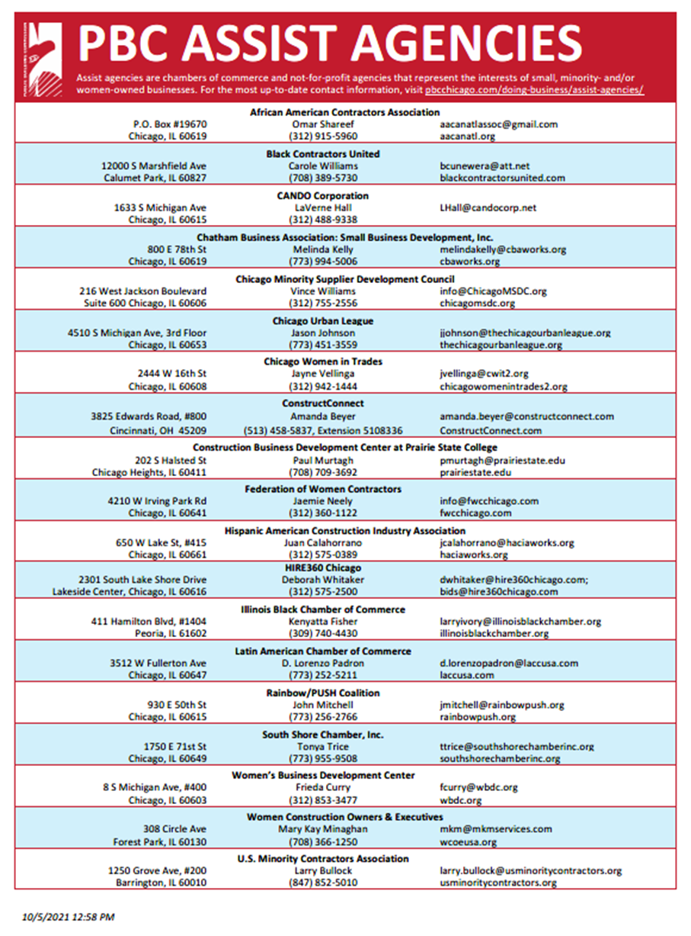
Procurement Details
AVAILABILITY OF DOCUMENTS
Assist Agencies

Slide 12
Procurement Details
TECH REVIEW MEETING
Date/Time
September 14, 2022 at 10:30 a.m.
(Immediately following this meeting)
SITE VISIT
None has been scheduled.
Notwithstanding
Failure of the Bidders to become familiar with the Project shall not relieve or alter the Bidder’s responsibility for completing the Work as required by the Contract Documents.

Slide 13
Procurement Details
REQUEST FOR INFORMATION (RFI’S)
Sole Point of Contact
James Borkman, Contract Officer
james.borkman@cityofchicago.org
Deadline
Current: September 21, 2022 by 4:30 p.m.
Addenda
None issued to date

Slide 14
Procurement Details
BID DUE DATE/TIME
Due Date/Time
September 29, 2022 at 11:00 a.m.
(Subject to Change via Addendum)
Virtual Meeting Details
NOTE: The Bid Opening will be streamed LIVE and will be RECORDED and AVAILABLE on our website for viewing on PBC’s Home Page www.pbcchicago.com and on the Current Opportunity page for this project found here: https://www.pbcchicago.com/opportunities/advertisement-for-bids-contract-c1603-wpastreetreconstructionmedillave/

Slide 15
Procurement Details
BID SUBMISSION REQUIREMENTS
If Electronic Submission
One complete copy of bid document
Original Signatures (blue ink) or Digital Signature
Include Bid Bond
Include Bid Form and Award Criteria sheet in PDF format separately within email
    NOTE: These two documents should be searchable PDF form and not a scanned copy.
Email to:
bids@pbcchicago.com AND james.borkman@cityofchicago.org
If Hardcopy Submission
Include two, single-sided copies in SEALED ENVELOPE
Original Signatures (blue ink)
Include 5% Bid Bond
Label envelope ‘BID DOCUMENTS’ and include, at minimum, Contract Name and Number, Firm Name and Address; and day/time of bid opening
Mail or hand-deliver/messenger to:
          Public Building Commission of Chicago (PBC)
          50 West Washington Street, Suite 200
          Chicago, Illinois 60602
PBC offices will only be open for drop off of bids on the designated date of receipt beginning at 9:30a.m.
NOTE: Mail has been sporadic due to COVID-19. The PBC highly recommends firms submit their bid electronically

Slide 16
Procurement Details
PRE-AWARD MEETING
Date/Time
Friday, September 30, 2022 at 11:00 a.m. (Virtual)
(Subject to Change via Addendum)
NOTICE OF AWARD
Anticipated Schedule
Anticipated release of the Notice of Award (NOA) is October 2022 PBC Board of Commissioners Meeting
Successful General Contractor will be required to provide compliant Certificate of Insurance and Payment and Performance Bond within 5 to 7 days of NOA issuance

Slide 17
Book 1 & 2 Highlights
Compliance

Slide 18
Highlights
BOOK 1 AND BOOK 2 HIGHLIGHTS
        Budget, Staffing, and Additional Requirements
Estimated Construction Budget (Book 1, Page 4) – $900,000 - $1,100,000
Mandatory Project Staffing (Book 1, Page 5)
Scheduling Software Requirements (Book 1, Page 6)
Liquidated Damages (Book 1, Page 6)
Prevailing Wage Rates (Book 1, Page 7)

Slide 19
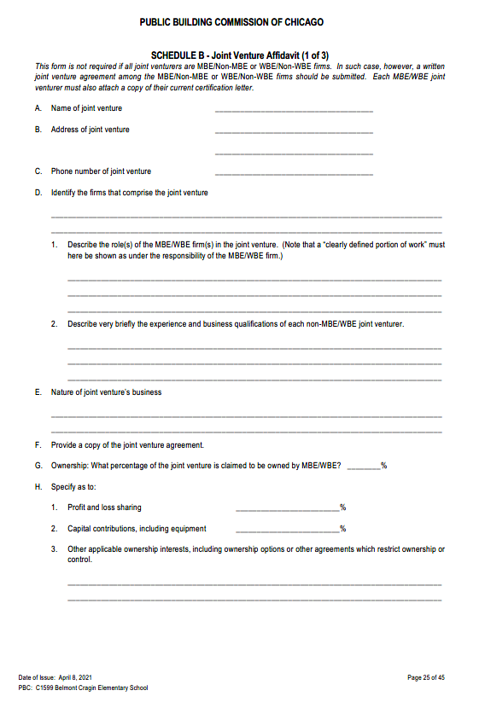
Highlights
BOOK 1 AND BOOK 2 HIGHLIGHTS
        Joint Venture Opportunities
    Schedule B – Joint Venture Affidavit
(Book 1, Page 25)
        JV Agreement
        Certification Letter

Slide 20
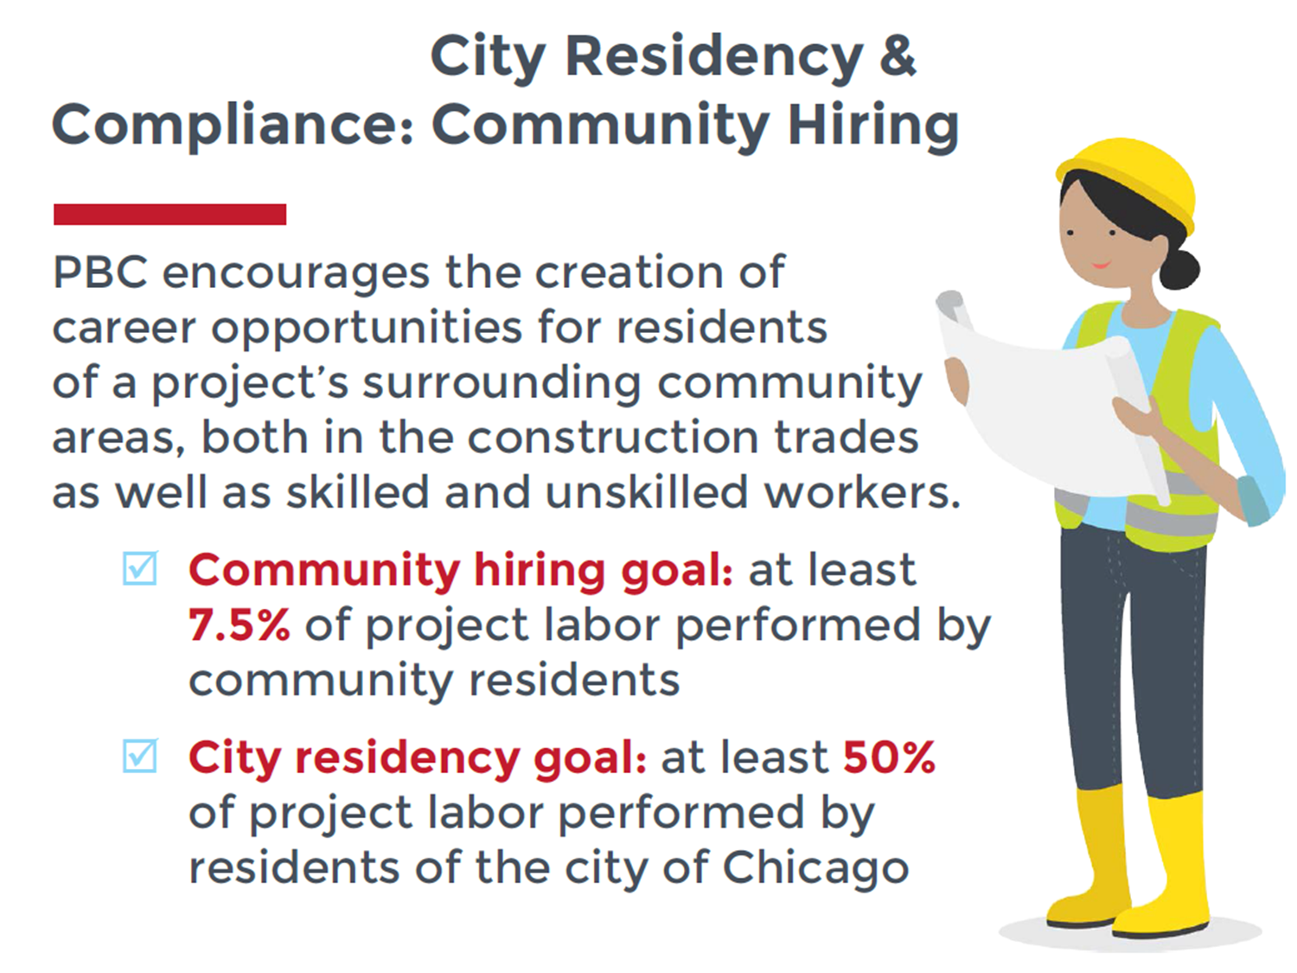
Highlights
BOOK 1 AND BOOK 2 HIGHLIGHTS
        Award Criteria Figure
        Maximum 70%
          Minority Journeyworker, Apprentice, and;
          Laborer
          Maximum 15%
          Female Journeyworker, Apprentice, and;
          Laborer
        City Residency &
        Community Hiring

Slide 21
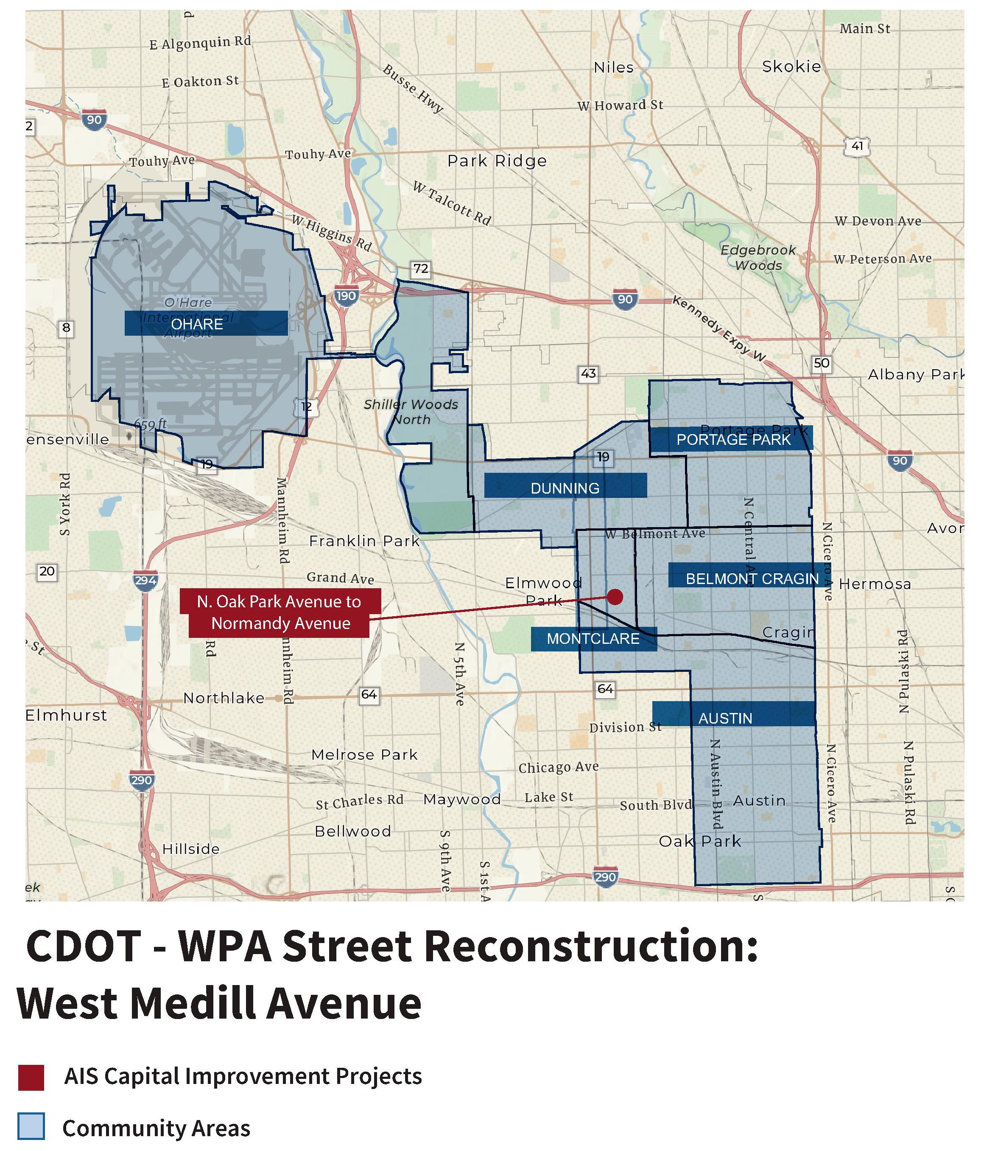
Highlights
        Community Hiring
        MAP

Slide 22
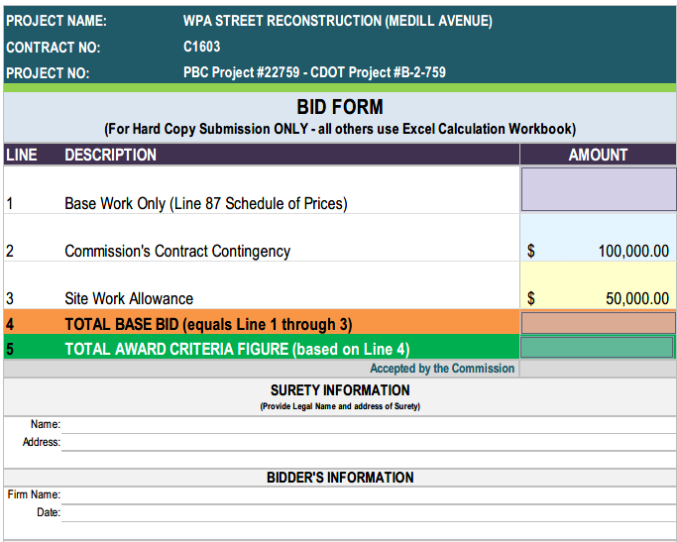
Highlights
        THE BID FORM

Slide 23
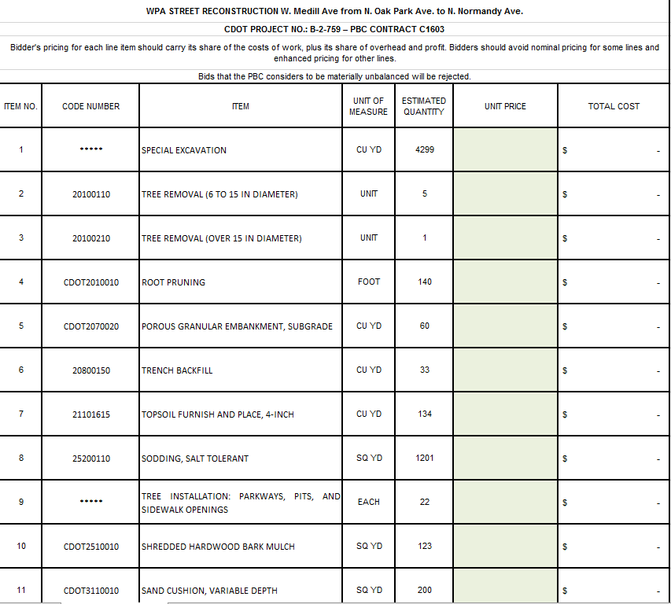
Highlights
        THE BID FORM – SCHEDULE OF PRICES

Slide 24
Highlights
        AWARD CRITERIA FIGURE

Slide 25
Highlights
BOOK 1 AND BOOK 2 HIGHLIGHTS
        Basis of Award (Book 1, Page 10)
Award will be made to the responsible Bidder submitting the Lowest Award Criteria Figure and otherwise responsive to all the requirements of the Contract Documents.
Bidder’s pricing for each line item should carry its share of the costs of work, plus its share of overhead and profit.
Bids that the PBC considers to be materially unbalanced will be rejected.
Firms are required to fill out the entire BID FORM to be considered responsive.

Slide 26
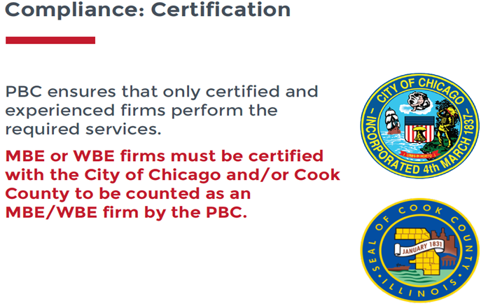
Compliance
MBE/WBE PARTICIPATION
MBE/WBE Goal
26%, MBE
6%, WBE
MBE/WBE Special Conditions
Book 2, Article 23
MBE/WBE Certifications
City of Chicago
Cook County

Slide 27
Compliance
MBE/WBE
COMPLIANCE
Documentation and Monitoring
B2Gnow: MBE/WBE Compliance monitoring
Established Business, Manufacturers, Suppliers, and Brokers
Schedule D
Schedule C

Slide 28
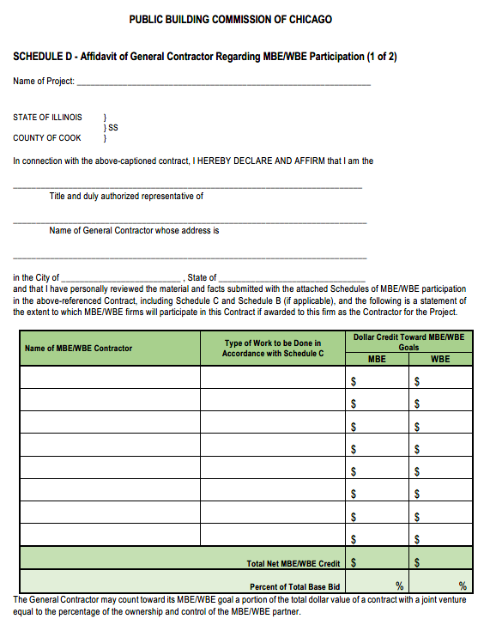
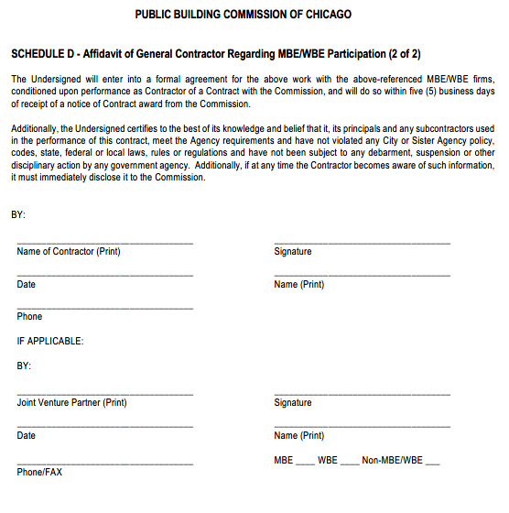
Compliance
MBE/WBE
COMPLIANCE
Schedule D

Slide 29
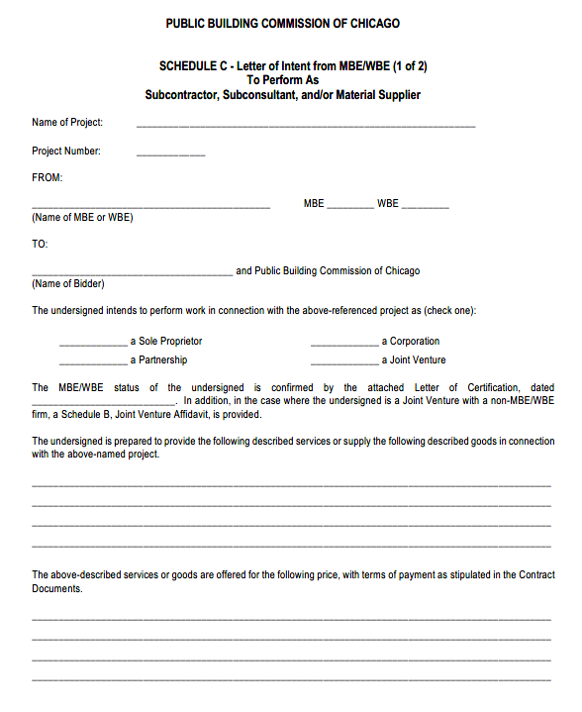
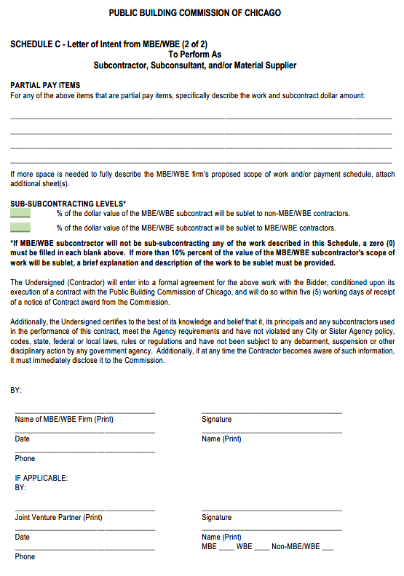
Compliance
MBE/WBE
COMPLIANCE
Schedule C

Slide 30
PBC CONTACT
James Borkman
james.borkman@cityofchicago.org

Slide 31
Technical Review

Slide 32
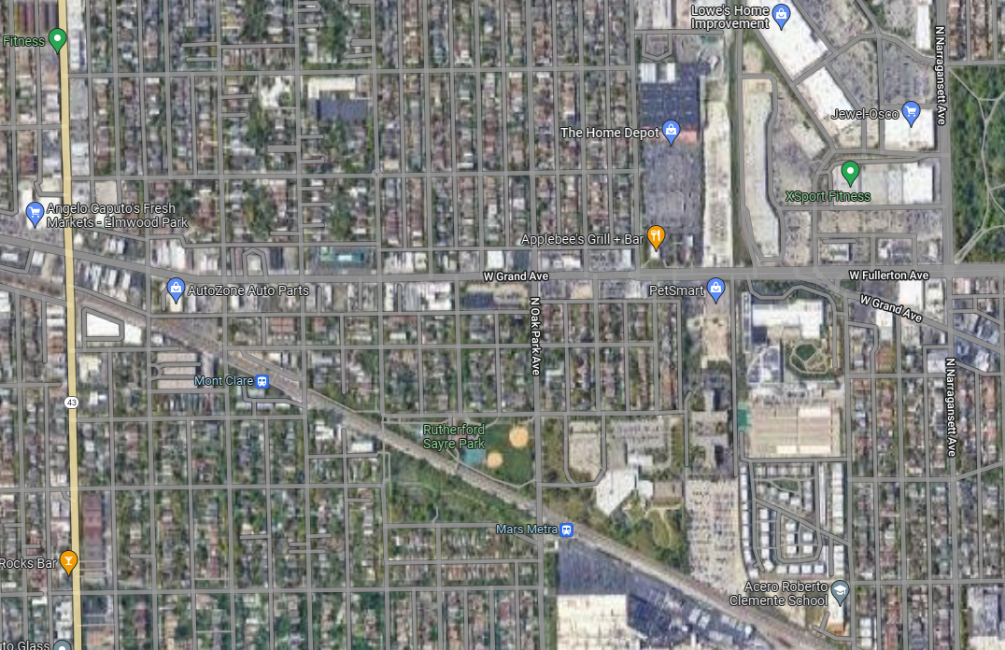
Project Overview
Project Location
W. Medill Avenue from N. Oak Park Avenue to N. Normandy Avenue
Project Overview
Existing Conditions
Proposed Conditions
Grand Avenue
Medill Avenue
Harlem Avenue
Narragansett Avenue
Oak Park Avenue
Normandy Avenue

Slide 33
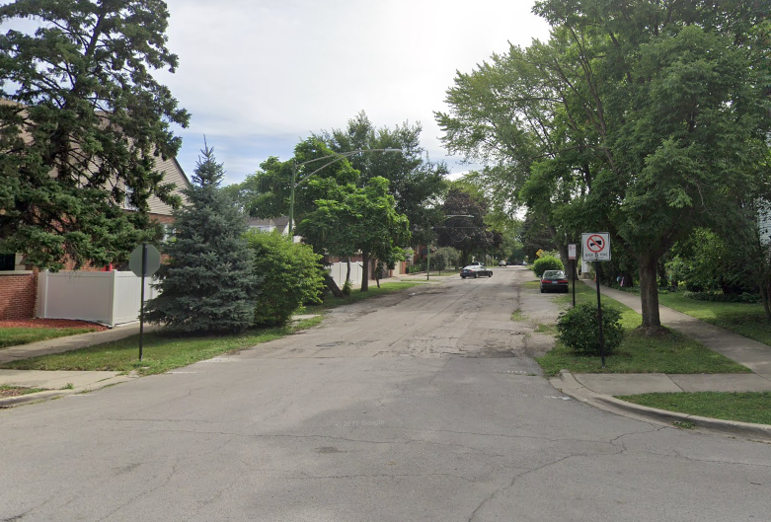
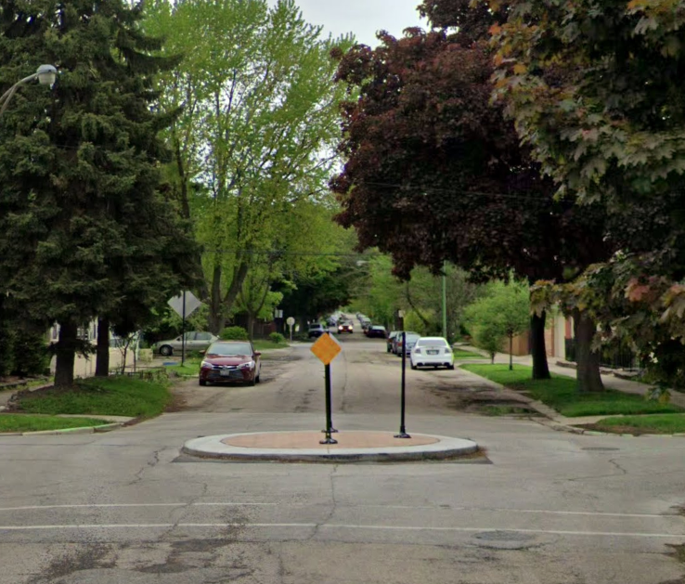
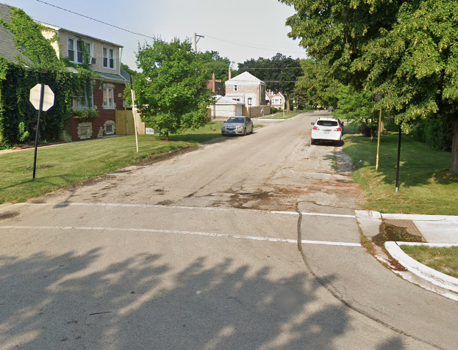
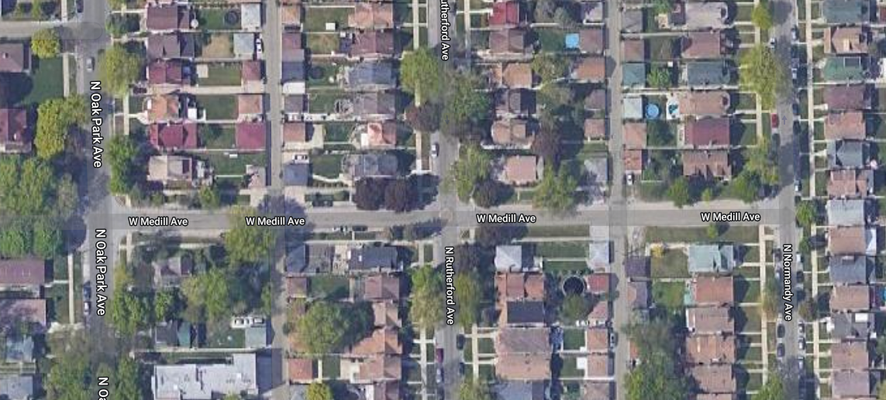
Existing Conditions
Roadway
Roadway width varies from 20’ – 32’
Three Intersections:
    N. Oak Park Ave
  N. Rutherford Ave
  N. Normandy Ave

Slide 34
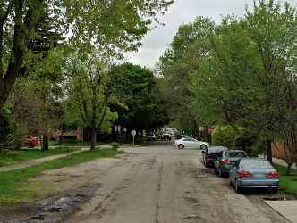
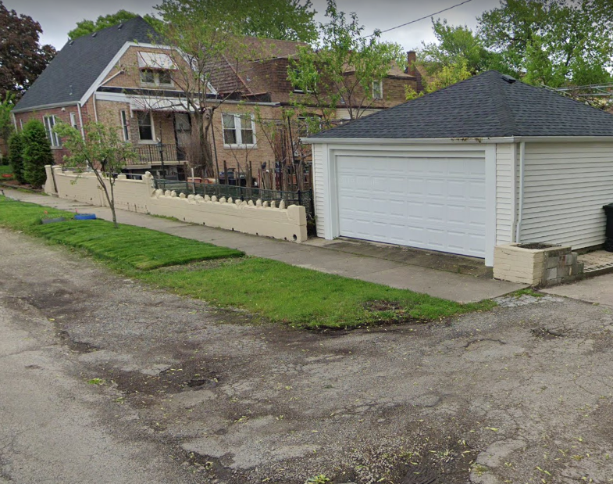
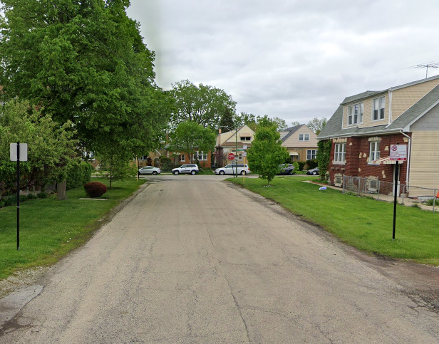
Existing Conditions (cont)
Narrow roadway allows vehicles to park in the grass parkway
Poor pavement condition
Lack of curb & gutter leads to standing water in the public ROW
Garages are missing driveways
Sidewalk is not present between Normandy and the nearest alley to the west
Non-Compliant ADA ramps

Slide 35
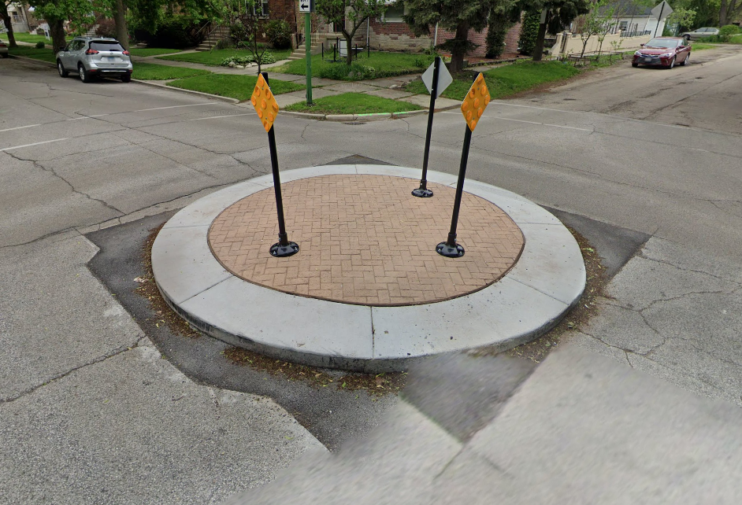
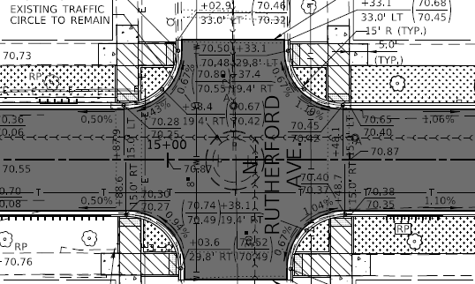
Existing Conditions (cont)
Traffic Circle
Existing traffic circle in the Medill Avenue and Rutherford Avenue intersection.
The traffic circle is to be maintained and protected by the contractor during construction per the contract documents.

Slide 36
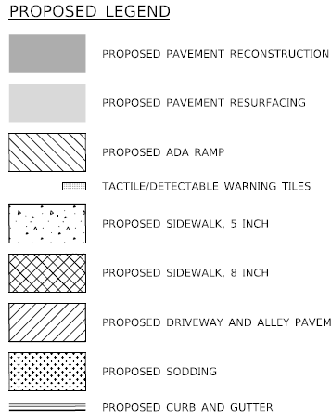
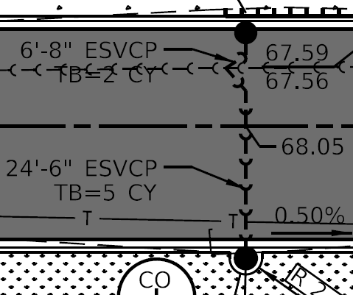
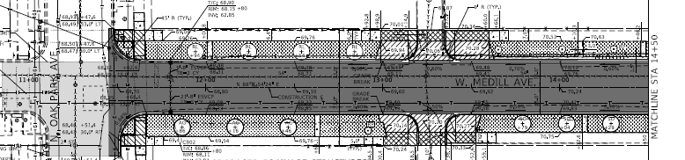
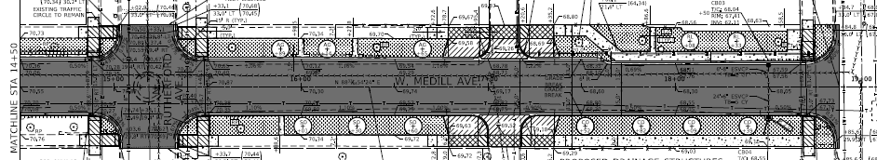
Proposed Conditions
Roadway
Widen roadway to 30’ width and install curb & gutter
Reconstruct or construct new driveways and alley aprons
Install new catch basins and sewer laterals to connect to the existing sewer mainline

Slide 37
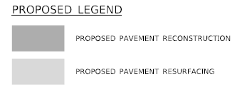
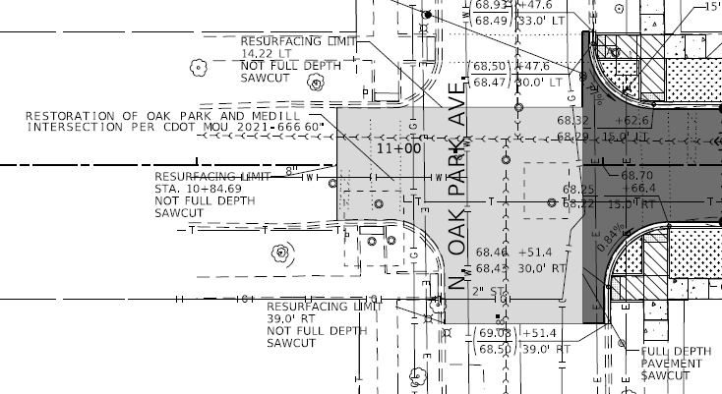
Proposed Conditions (cont)
Medill and Oak Park Resurfacing
Contractor is responsible for resurfacing in the Medill Avenue and Oak Park Avenue intersection, up to the limits shown in the contract documents.
This work is needed due to a resurfacing agreement between CDOT and CDWM.

Slide 38
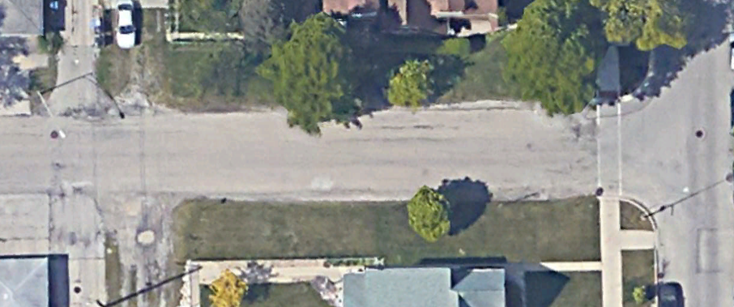
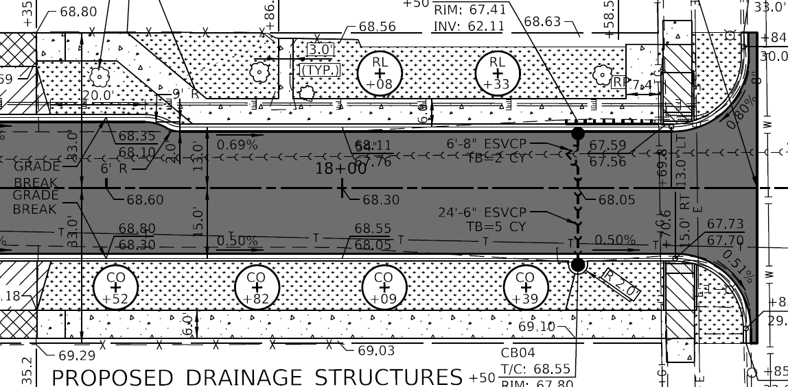
Proposed Conditions (cont)
Sidewalk
Install new sidewalks on Medill Avenue between Normandy Avenue and the nearest alley to the west
Proposed sidewalk on north side of Medill jogs south to avoid damaging existing mature trees
  Results in full pedestrian connectivity through project area

Slide 39
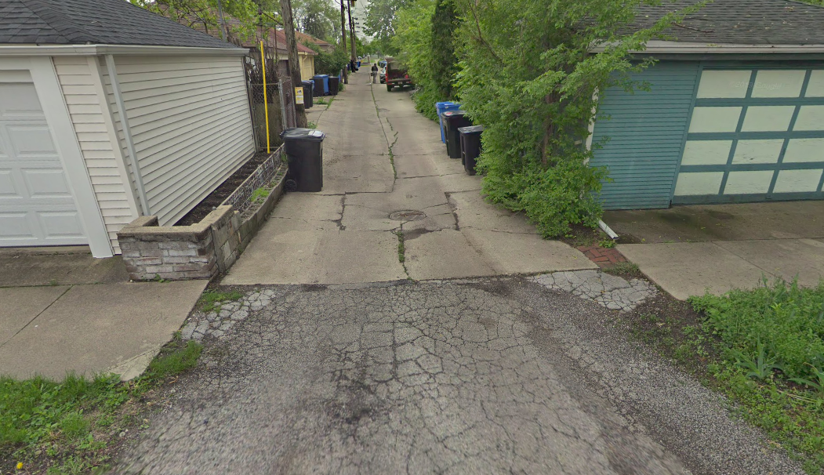
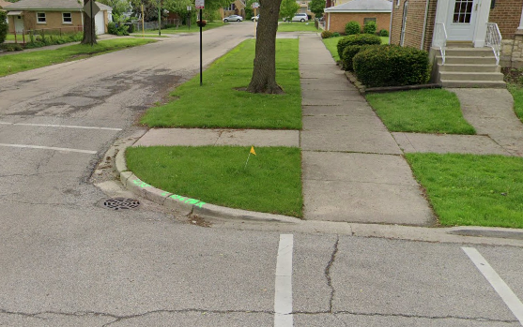
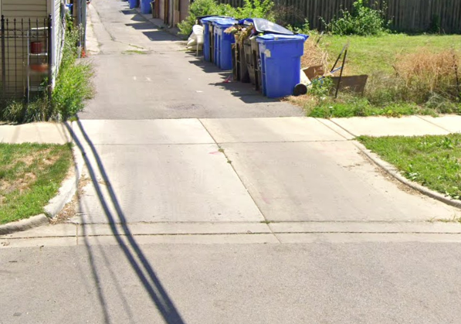
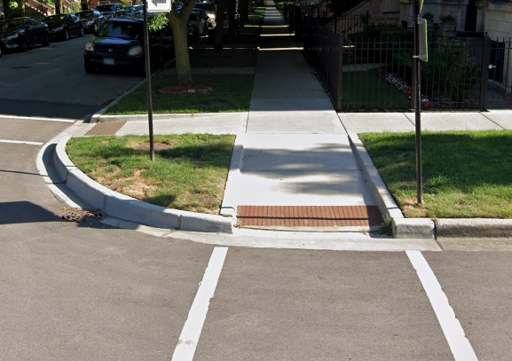
Proposed Conditions (cont)
Sidewalk
Reconstruct pedestrian ramps at each intersection to meet ADA standards
Place detectable warning tiles at each ADA ramp
Add new crosswalk pavement markings
Install new sidewalks at alley crossings

Slide 40
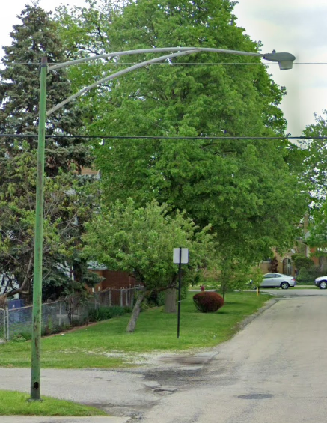
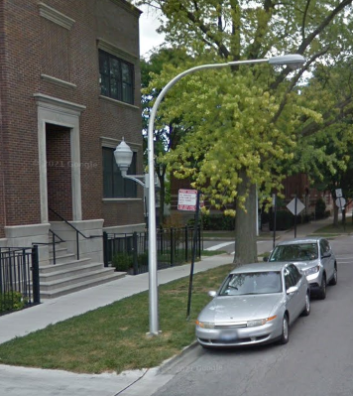
Proposed Conditions (cont)
Lighting
Install new street lighting which includes piggyback lighting for pedestrians
  One light pole provides lighting for both the street and sidewalk
Upgraded LED lamps

Slide 41
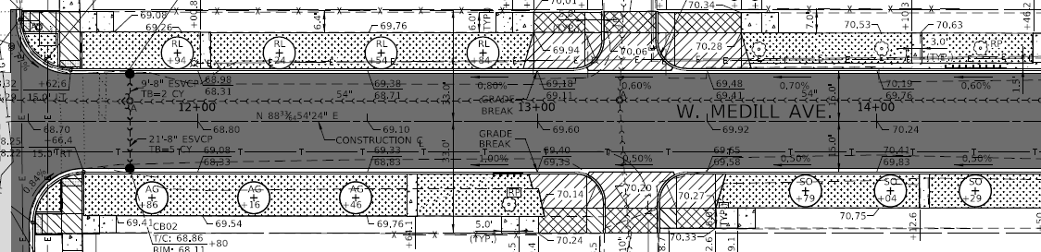
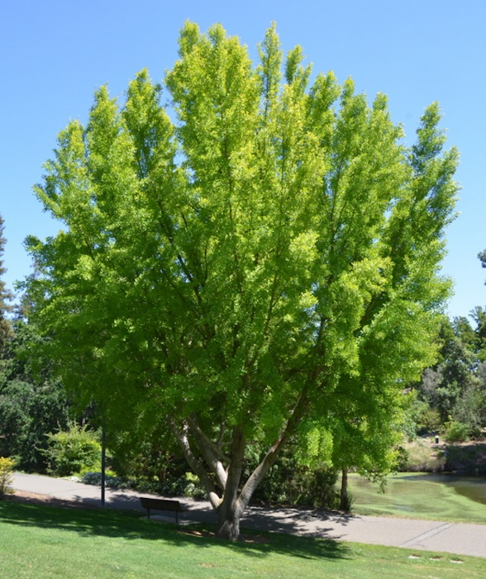
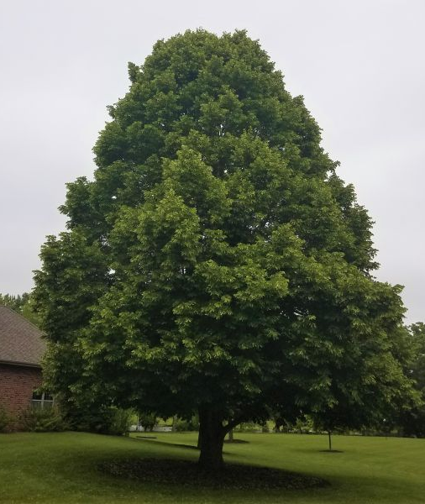
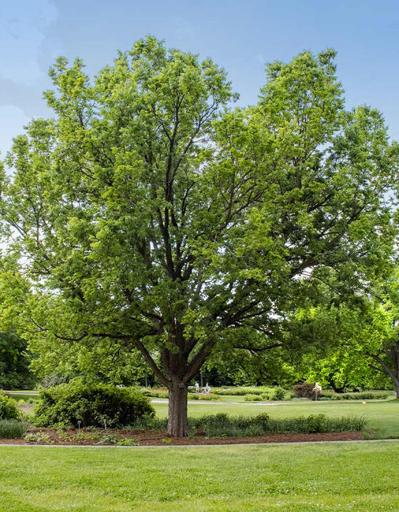
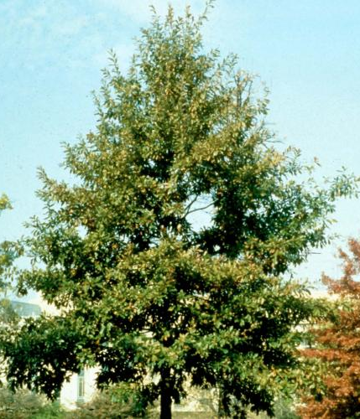
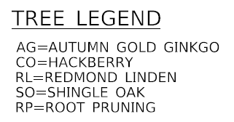
Proposed Conditions (cont)
Landscaping
New trees to be planted in the parkway
New grass sod to be placed in the parkway
Refer to contract documents for removal of existing trees in the parkway

Slide 42
Q&A

