Slide 1


Slide 2


HOUSEKEEPING ITEMS
While we wait…
Please MUTE your computers and/or cellphones
Press *6 to unmute (if asked to speak)
Please CHANGE your screen name
Use ‘Your Name (Company Name (or Initials))
    EXAMPLE: James B (PBC)
Please ADD your name to Chat
Use ‘Your Name|Company Name (or Initials)’
    EXAMPLE: James Borkman (PBC)
Please WAIT for Q&A to ask questions
Q&A session will be at the end of each meeting
Feel free to use the ‘Chat’ feature

Slide 3
Works Progress Administration (“WPA”) Streets Reconstruction Fillmore Street
C1605
Pre-Bid and Technical Review Meeting
November 28, 2023 at 10:00am

Slide 4
AGENDA
Introductions
Procurement Details
Compliance
Technical Review
Q&A

Slide 5
Introductions

Slide 6
INTRO
PBC
CDOT
General Contractors
Sub-Contractors/Suppliers

Slide 7
Procurement Details

Slide 8
Procurement Details
PROJECT OVERVIEW
Project Location
WEST FILLMORE STREET FROM SOUTH CAMPBELL AVENUE TO DEAD END WEST - Chicago, Illinois
General Scope of Work
Full depth pavement reconstruction
Special excavation
Portland Cement concrete Base course
Hot-Mix Asphalt Surface course
Sewer Main and Drainage Structures
Water Main
Lighting
Concrete Curb, Gutter, ADA Curb Ramps, Sidewalks, Driveways and Alleys
Pavement markings and signs
Topsoil, Sodding, and Tree Planting
Associated Site Development

Slide 9
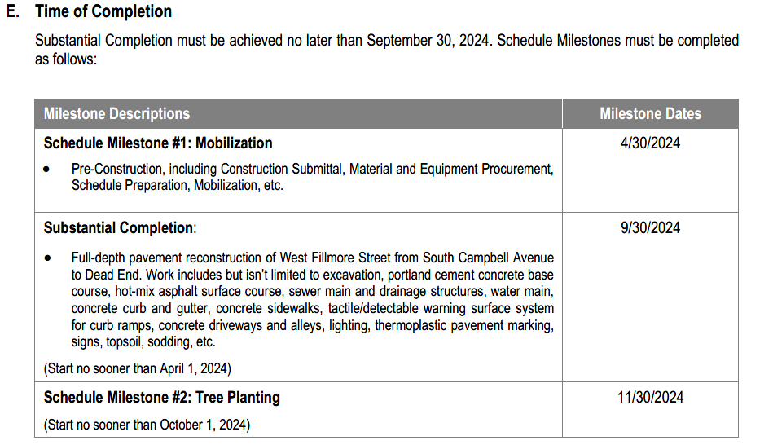
Procurement Details
PROJECT OVERVIEW
Time of Completion
Liquidated Damages
$1,000.00 per day – For failure to achieve Substantial Completion
$500 per day - For failure to achieve milestone date(s)

Slide 10
Procurement Details
AVAILABILITY OF DOCUMENTS
Online Planroom
Cushing and Company Planroom
Printer Contact Information
Cushing and Company
213 West Insitute Place, Suite 200
Chicago, Illinois 60610
Contact Name: Jorge Galvan
Telephone Number: 312-266-8228

Slide 11
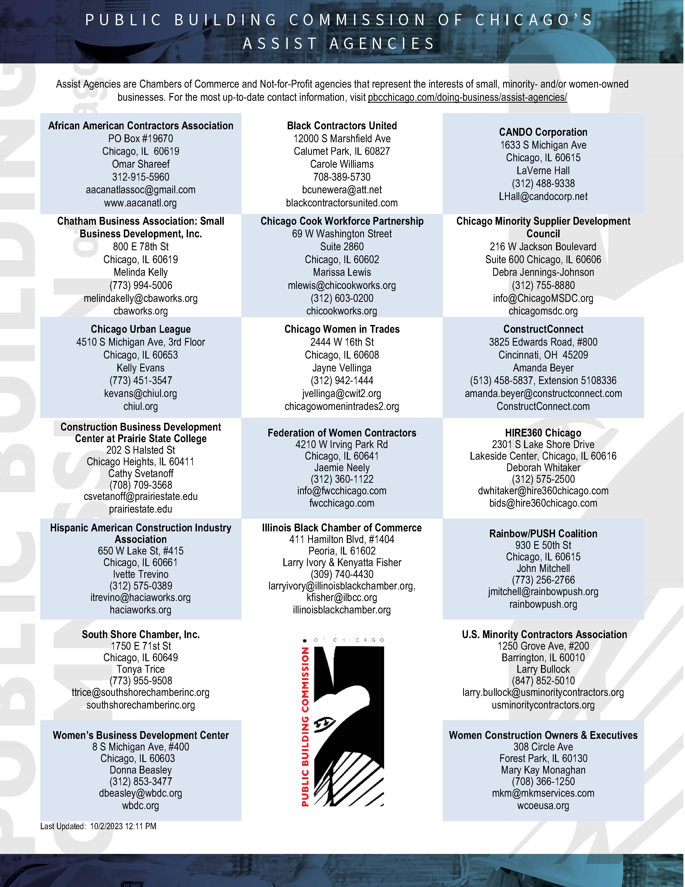
Procurement Details
Assist Agencies

Slide 12
Procurement Details
TECH REVIEW MEETING
Date/Time
November 28, 2023 at 10:30 a.m.
(Immediately following this meeting)
SITE VISIT
None has been scheduled.
Notwithstanding
Failure of the Bidders to become familiar with the Project shall not relieve or alter the Bidder’s responsibility for completing the Work as required by the Contract Documents.

Slide 13
Procurement Details
REQUEST FOR INFORMATION (RFI’S)
Sole Point of Contact
James Borkman, Contract Officer
james.borkman@cityofchicago.org
Deadline
Current: December 8, 2023 by 4:00 p.m.
Addenda
None issued to date

Slide 14
Procurement Details
BID DUE DATE/TIME
Due Date/Time
December 19, 2023 at 11:00 a.m.
(Subject to Change via Addendum)
Virtual Meeting Details
NOTE: The Bid Opening will be streamed LIVE and will be RECORDED and AVAILABLE on our website for viewing on PBC’s Home Page www.pbcchicago.com and on the Current Opportunity page for this project found here: https://www.pbcchicago.com/opportunities/advertisement-for-bids-contract-c1603-wpastreetreconstructionmedillave/

Slide 15
Procurement Details
BID SUBMISSION REQUIREMENTS
Electronic Submission
One complete copy of bid document
Original Signatures (blue ink) or Digital Signature
Include Bid Bond
Include Bid Form and Award Criteria sheet in PDF format separately within email
    NOTE: These two documents should be searchable PDF form and not a scanned copy.
Email to:
bids@pbcchicago.com AND james.borkman@cityofchicago.org
If Hardcopy Submission Needed
Bidders who are unable to submit their bids electronically may request instruction for submitting a “hard copy” of their bid in writing to the Contract Officer: James Borkman at james.borkman@cityofchiago.org

Slide 16
Procurement Details
PRE-AWARD MEETING
Date/Time
Wednesday, December 20, 2023 at 11:00 a.m. (Virtual)
(Subject to Change via Addendum)
NOTICE OF AWARD
Anticipated Schedule
Anticipated release of the Notice of Award (NOA) is January 2024 PBC Board of Commissioners Meeting
Successful General Contractor will be required to provide compliant Certificate of Insurance and Payment and Performance Bond within 5 to 7 days of NOA issuance

Slide 17
Book 1 & 2 Highlights
&
Compliance

Slide 18
Highlights
BOOK 1 AND BOOK 2 HIGHLIGHTS
        Budget, Staffing, and Additional Requirements
Estimated Construction Budget (Book 1, Page 4) – $1,800,000 - $2,000,000
Mandatory Project Staffing (Book 1, Page 5)
Scheduling Software Requirements (Book 1, Page 6)
Liquidated Damages (Book 1, Page 6)
Prevailing Wage Rates (Book 1, Page 7)

Slide 19
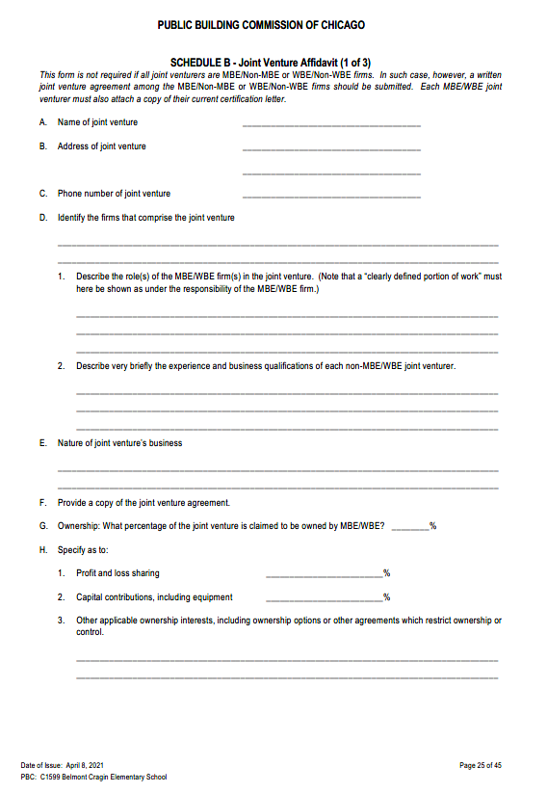
Highlights
BOOK 1 AND BOOK 2 HIGHLIGHTS
        Joint Venture Opportunities
    Schedule B – Joint Venture Affidavit
(Book 1, Page 25)
        JV Agreement
        Certification Letter

Slide 20
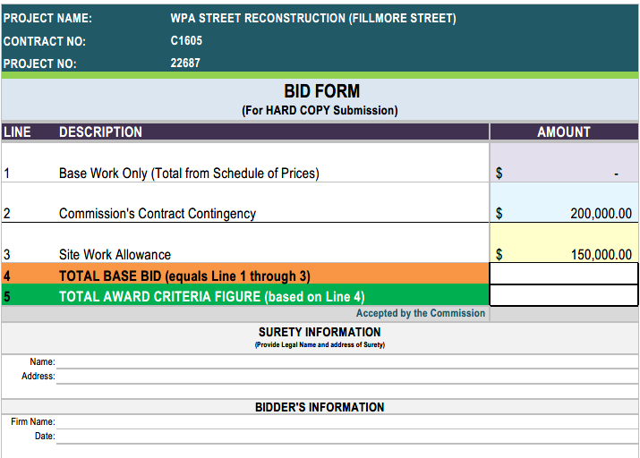
Highlights
        THE BID FORM

Slide 21
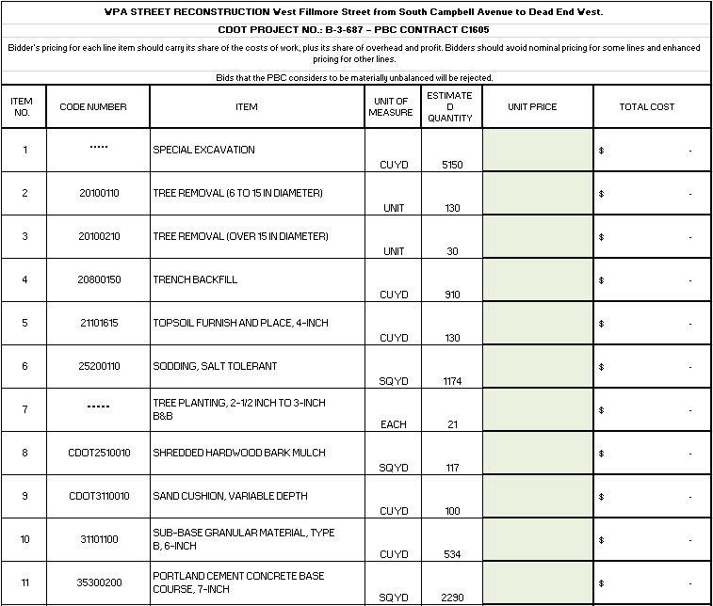
Highlights
        THE BID FORM – SCHEDULE OF PRICES

Slide 22
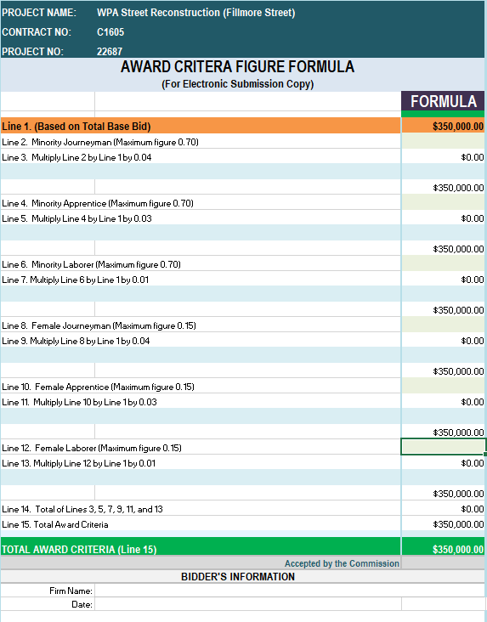
Highlights
        AWARD CRITERIA FIGURE

Slide 23
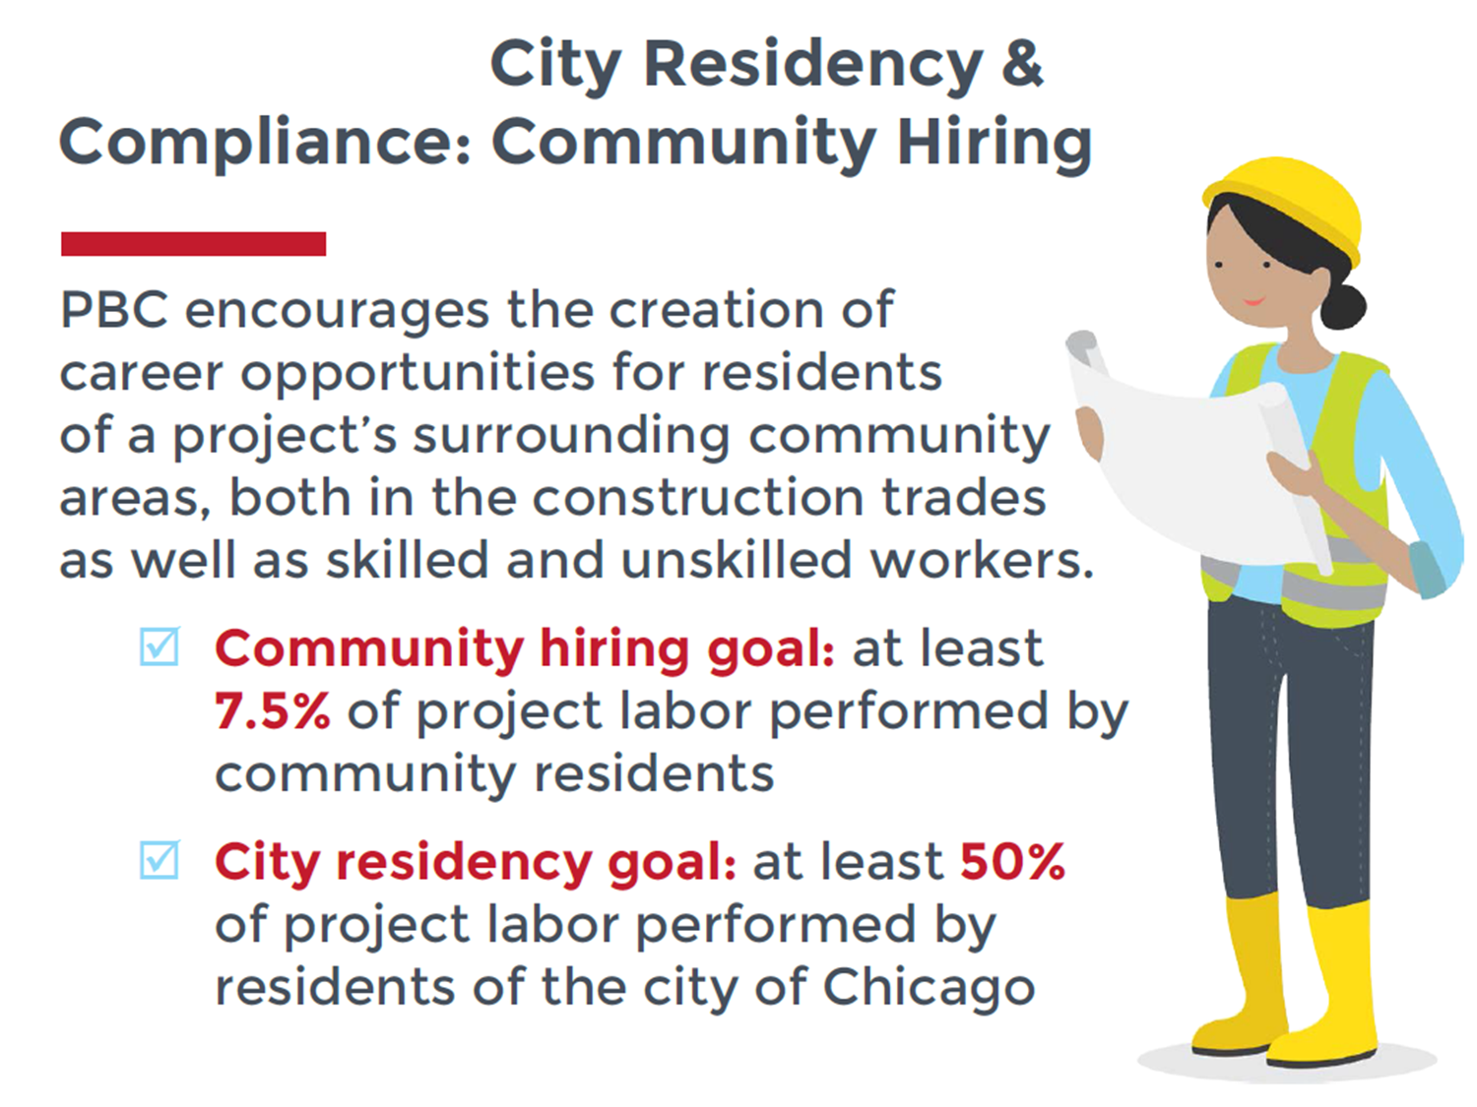
Highlights
BOOK 1 AND BOOK 2 HIGHLIGHTS
        Award Criteria Figure
        Maximum 70%
          Minority Journeyworker, Apprentice, and;
          Laborer
          Maximum 15%
          Female Journeyworker, Apprentice, and;
          Laborer
        City Residency &
        Community Hiring

Slide 24
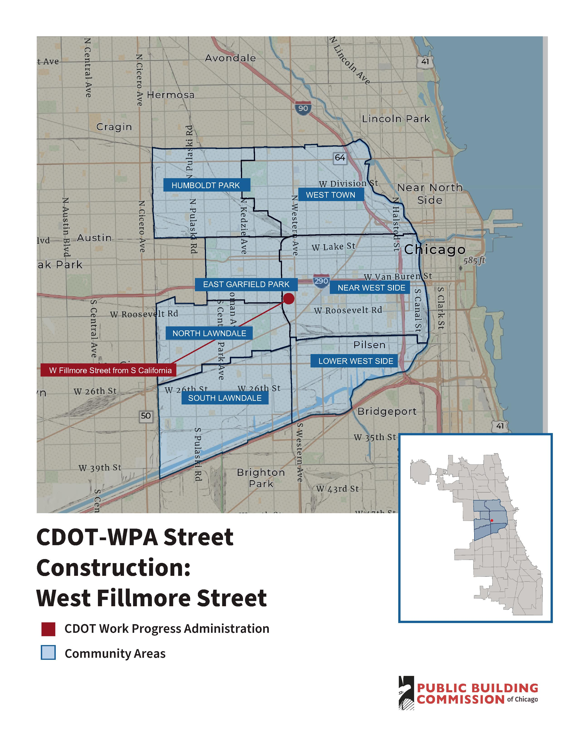
Highlights
        Community Hiring
        MAP

Slide 25
Highlights
BOOK 1 AND BOOK 2 HIGHLIGHTS
        Basis of Award (Book 1, Page 10)
Award will be made to the responsible Bidder submitting the Lowest Award Criteria Figure and otherwise responsive to all the requirements of the Contract Documents.
Bidder’s pricing for each line item should carry its share of the costs of work, plus its share of overhead and profit.
Bids that the PBC considers to be materially unbalanced will be rejected.
Firms are required to fill out the entire BID FORM to be considered responsive.

Slide 26

Compliance
MBE/WBE PARTICIPATION
MBE/WBE Goal
26%, MBE
6%, WBE
MBE/WBE Special Conditions
Book 2, Article 23
MBE/WBE Certifications
City of Chicago
Cook County

Slide 27
Compliance
MBE/WBE
COMPLIANCE
Documentation and Monitoring
B2Gnow: MBE/WBE Compliance monitoring
Established Business, Manufacturers, Suppliers, and Brokers
Schedule D
Schedule C

Slide 28
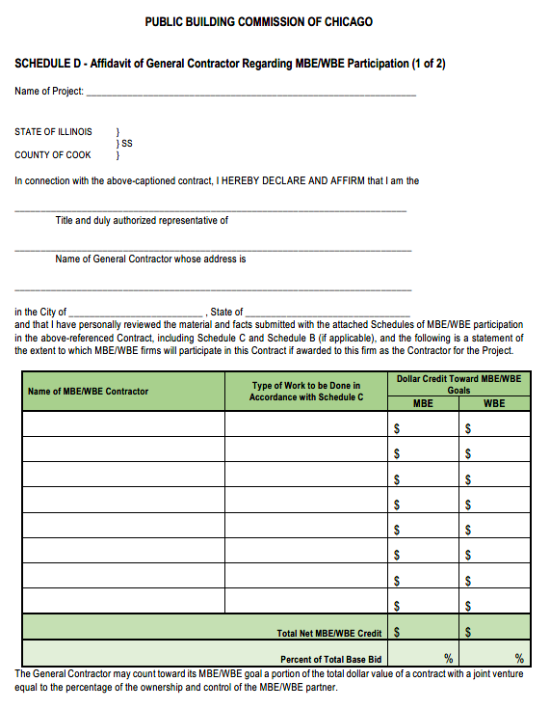
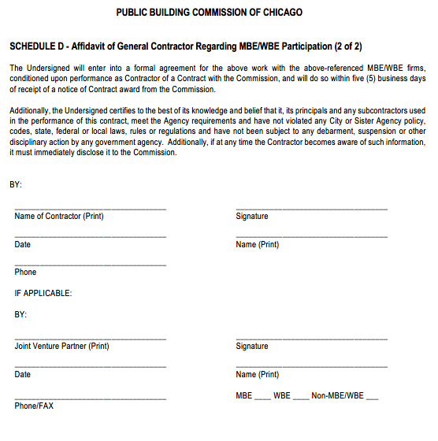
Compliance
MBE/WBE
COMPLIANCE
Schedule D

Slide 29
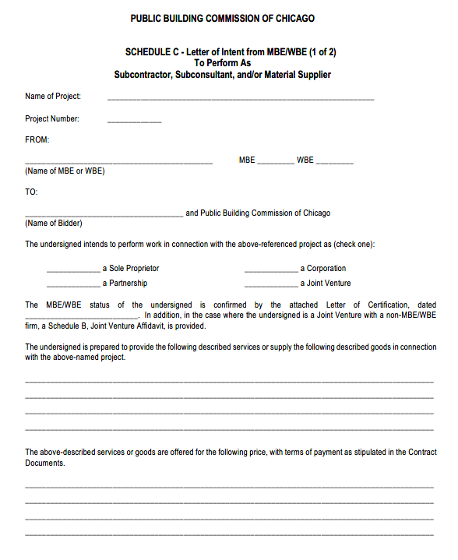
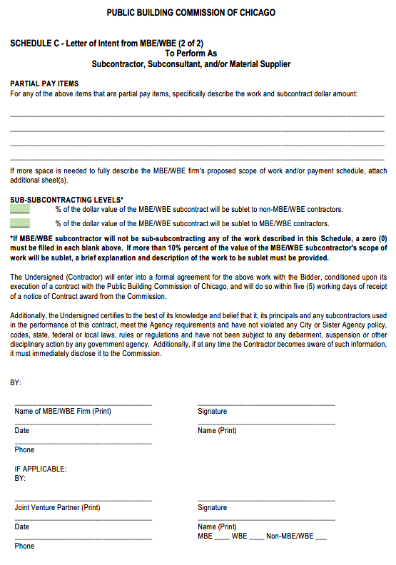
Compliance
MBE/WBE
COMPLIANCE
Schedule C

Slide 30
PBC CONTACT
James Borkman
james.borkman@cityofchicago.org

Slide 31
Technical Review

Slide 32
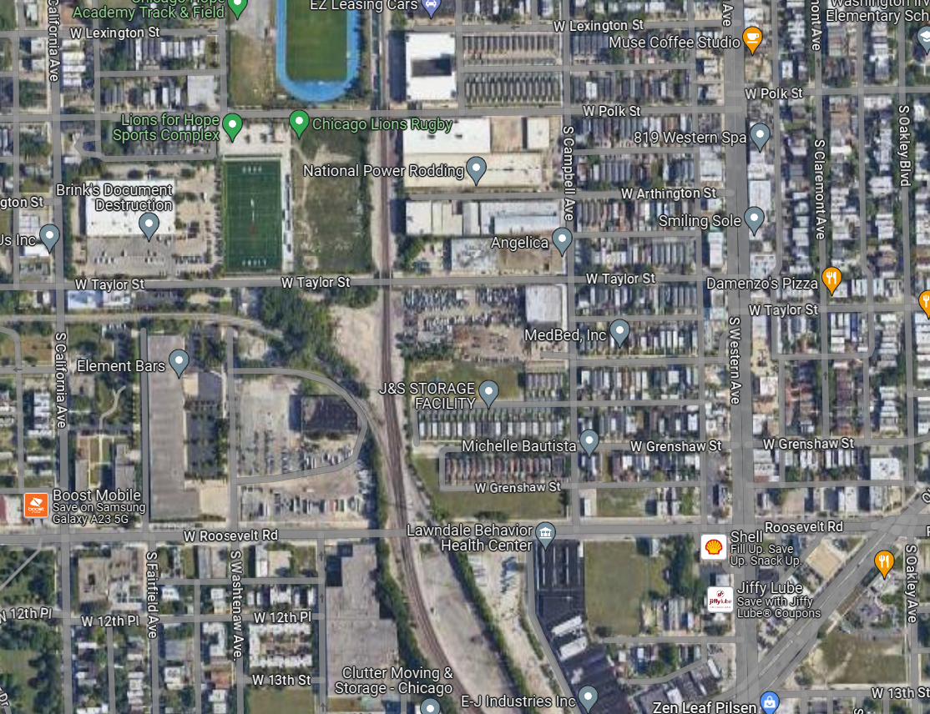
Project Overview
Project Location
W. Fillmore Street
South Campbell Ave to Dead End West
Project Overview
Existing Conditions
Proposed Conditions
W Taylor Street
W Fillmore Street
S Western Avenue
California Avenue
S Campbell Avenue
Roosevelt Road

Slide 33
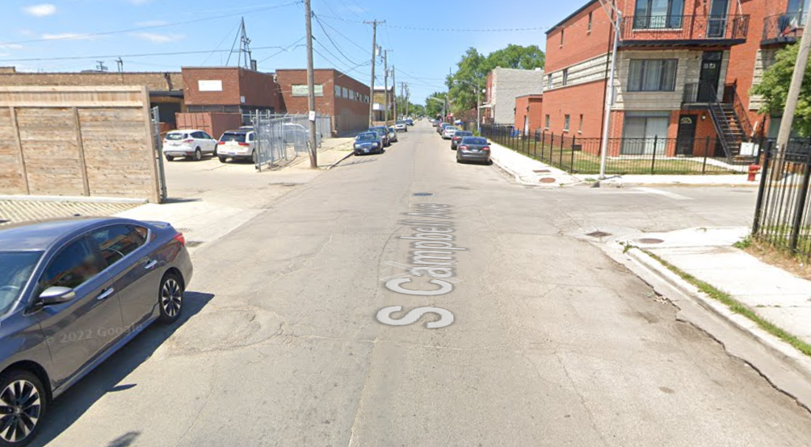
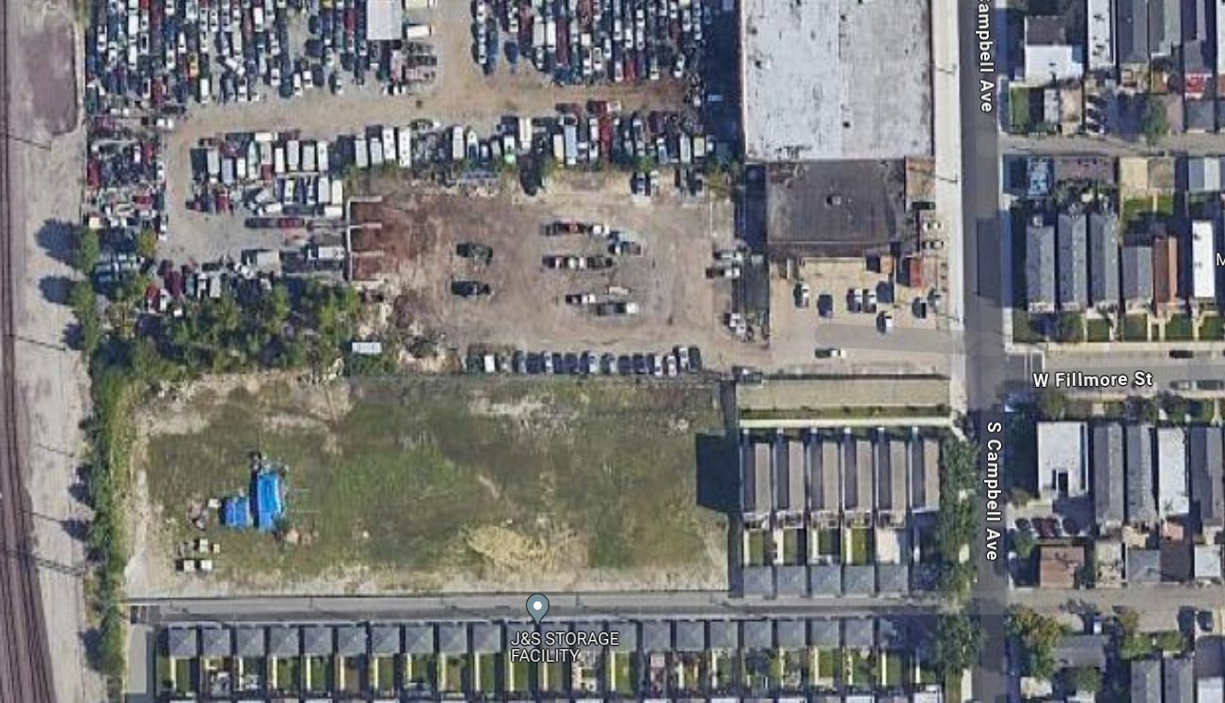
Existing Conditions
Roadway
Roadway width varies from 24’ – 32’.
One Intersection:
    S. Campbell Ave

Slide 34
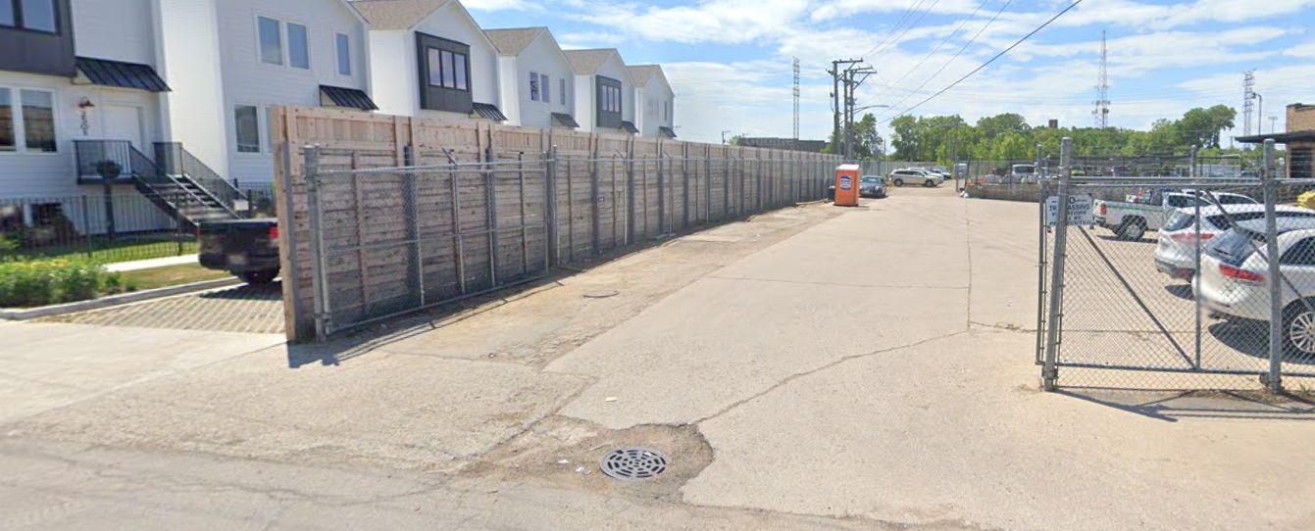
Existing Conditions (cont)
Roadway (cont)
No existing street west of Campbell Avenue
Lack of curb & gutter leads to standing water in the public ROW
170’ of sidewalk on the southside west of Campbell Ave
No East-West pedestrian crossings at Fillmore & Campbell.
Wood and chain link fences at centerline
Pavers on southside of street along the residential homes.

Slide 35
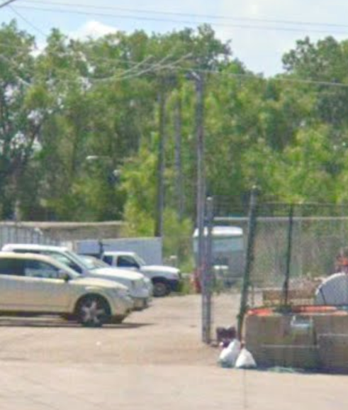
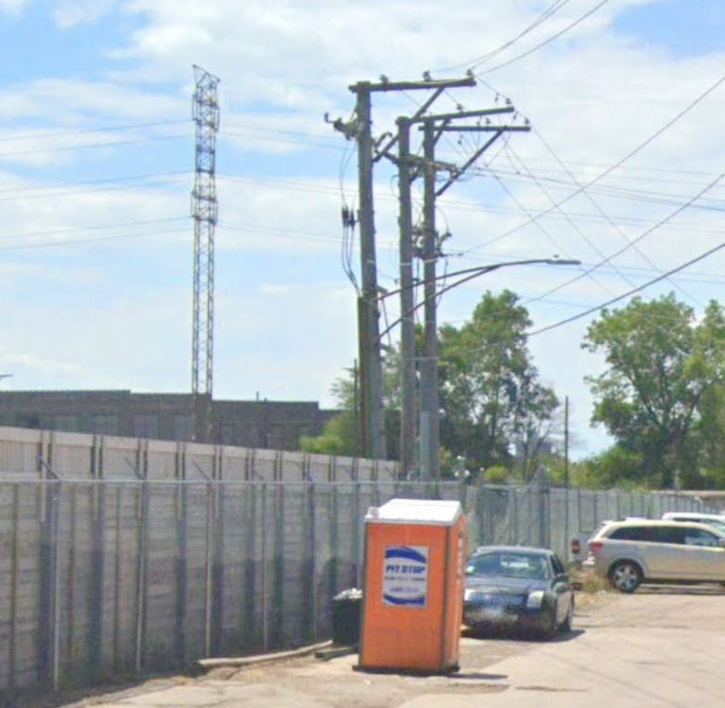
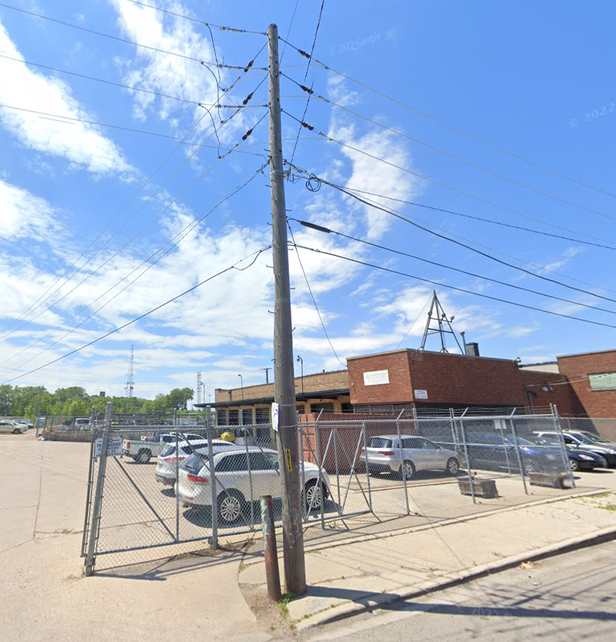
Existing Conditions (cont)
Utility Coordination ComED
Existing utility poles located within the existing ROW
6 utility poles will require relocation by ComEd
ComEd is responsible for the design, OUC coordination permitting and relocation.

Slide 36
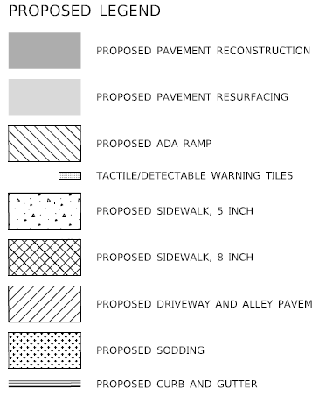
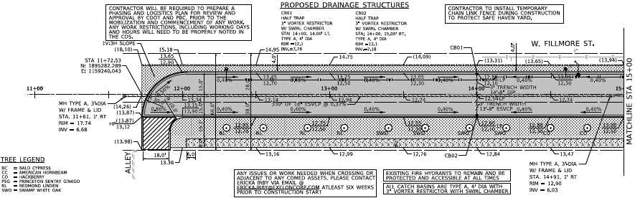
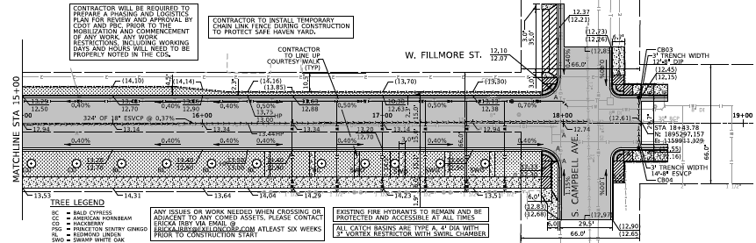
Proposed Conditions
Roadway
Clear & grade throughout project limits
Full depth pavement reconstruction
Widen roadway to 30’ width and install curb & gutter
Reconstruct or construct new driveways and alley aprons

Slide 37
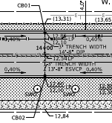
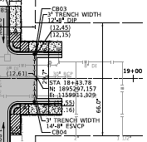
Proposed Conditions (cont)
Roadway (cont)
Remove existing sewer and construct new 18” sewer main
Install new catch basins and sewer laterals to connect to the existing and proposed sewer mainlines

Slide 38
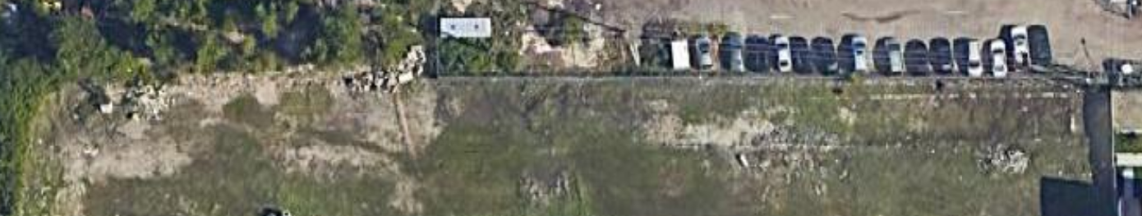
Proposed Conditions (cont)
Sidewalk
New sidewalk on the south side of Fillmore, but not on the north side.

Slide 39
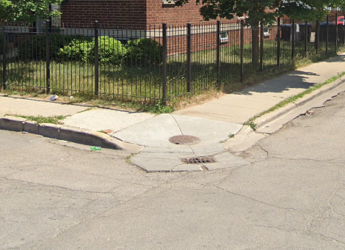
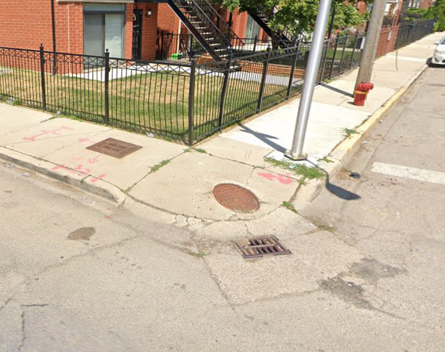
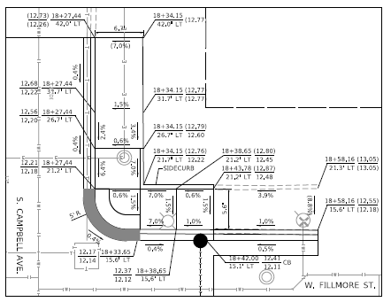
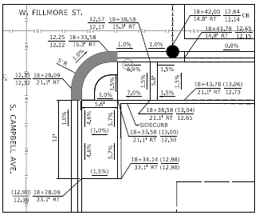
Proposed Conditions (cont)
Sidewalk (cont)
Reconstruct pedestrian ramps at Campbell to meet ADA standards
Place detectable warning tiles at each ADA ramp
Relocate catch basins to the east leg of Fillmore
Add new crosswalk pavement markings

Slide 40
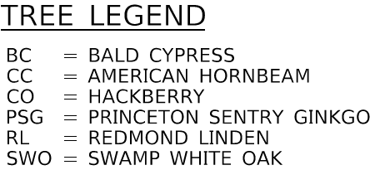
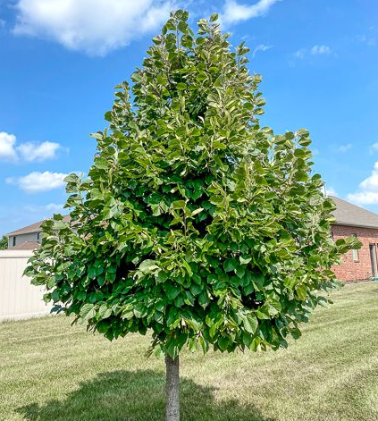
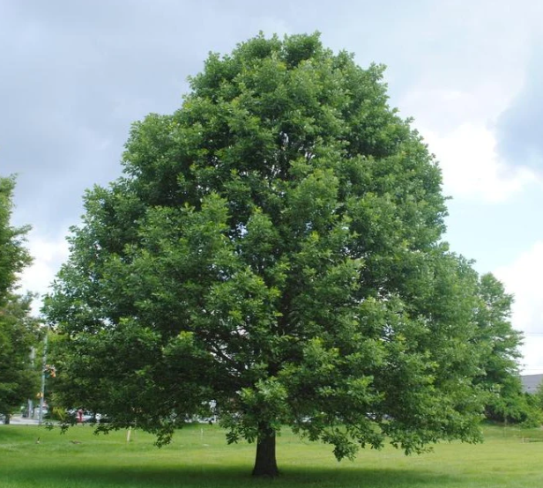
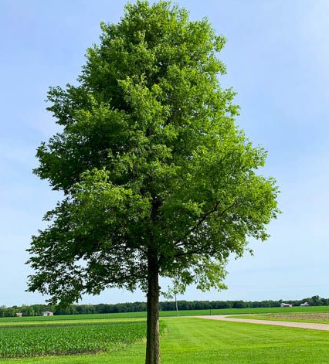
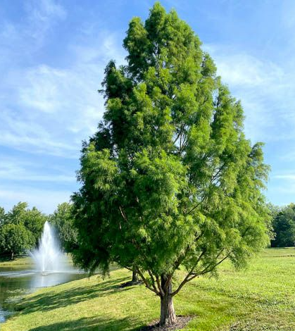
Proposed Conditions (cont)
Landscaping
New trees to be planted in the parkway on the south side
New grass sod to be placed in the parkway on the south side
Refer to contract documents for removal of existing trees in the parkway

Slide 41
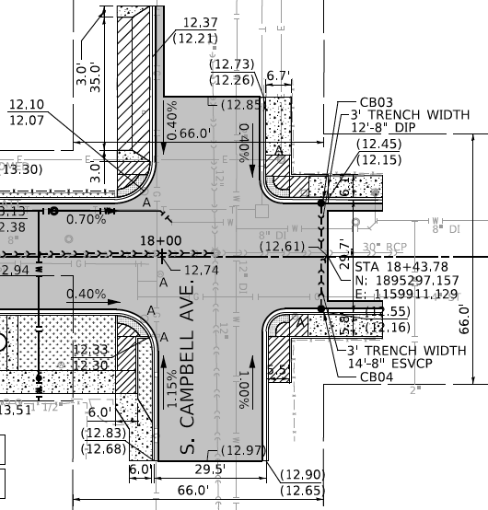
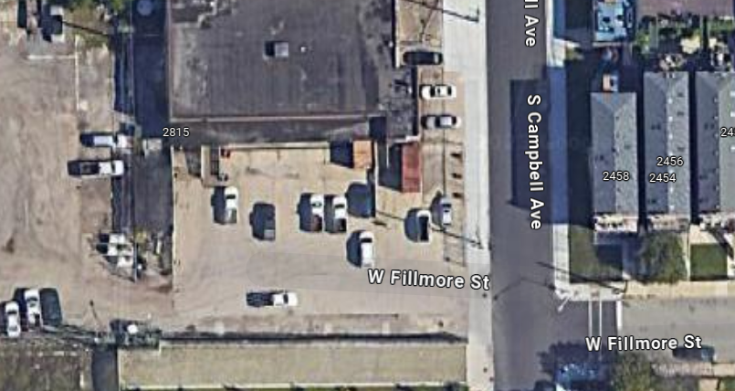
Proposed Conditions (cont)
Campbell & Fillmore Driveway Improvements
35’ driveway width
Property owner to relocate gate
Contractor is responsible for maintaining access to A Safe Haven yard
This work will take place after ComED relocate their utility poles

Slide 42
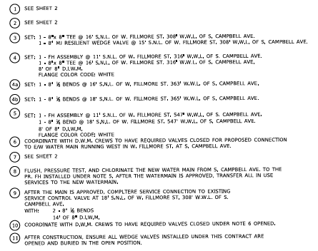
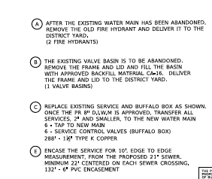
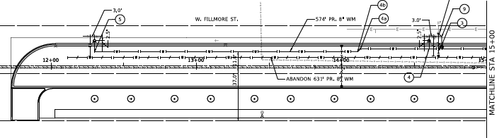
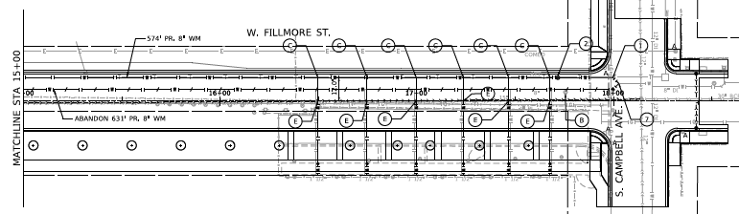
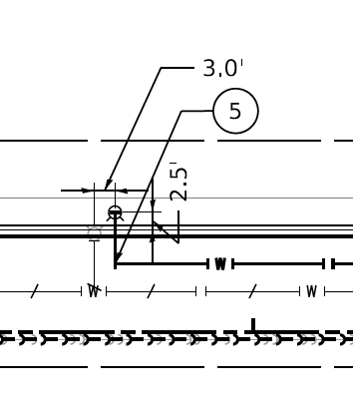
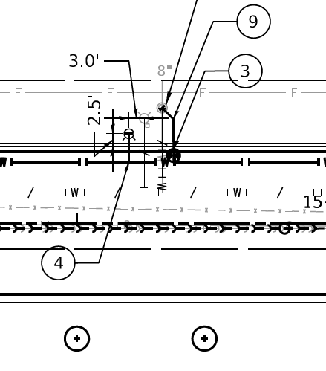
Proposed Conditions (cont)
Water Main
574’ proposed 8” DI Water Main
Two fire hydrants
New water service lines

Slide 43
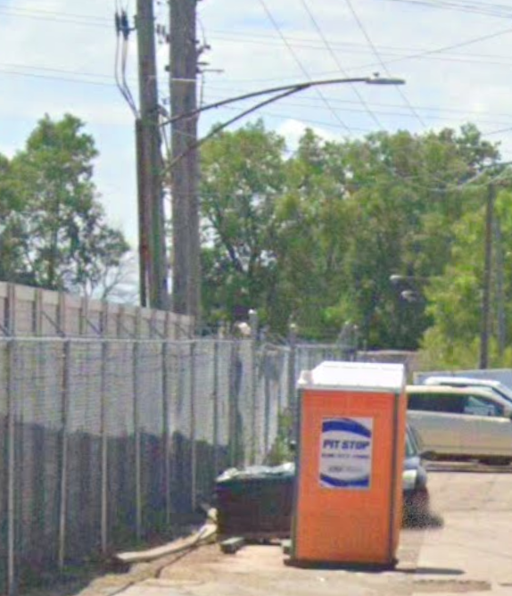
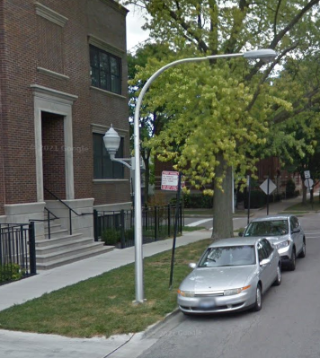
Proposed Conditions (cont)
Lighting
Install new street lighting including piggyback lighting for pedestrians
  One light pole provides lighting for both the street and sidewalk
Upgraded LED lamps

Slide 44
Q&A

