Slide 1
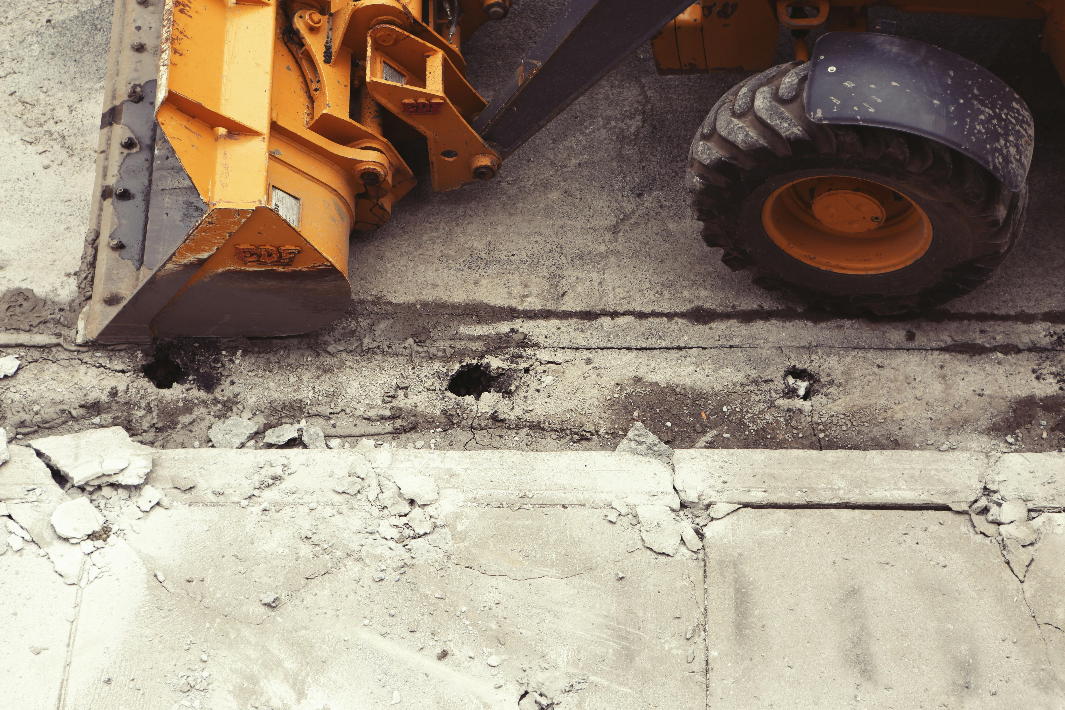


^{Brandon Johnson}
^{Mayor}
^{Ray Giderof}
^{Executive Director}

Slide 2


HOUSEKEEPING ITEMS
While we wait…
Please MUTE your computers and/or cellphones
Press *6 to unmute (if asked to speak)
Please CHANGE your screen name
Use ‘Your Name (Company Name (or Initials))
    EXAMPLE: James Borkman (PBC)
Please ADD your name to Chat
Use ‘Your Name|Company Name (or Initials)’
    EXAMPLE: James Borkman (PBC)
Please WAIT for Q&A to ask questions
Q&A session will be at the end of each meeting
Feel free to use the ‘Chat’ feature

Slide 3
Chicago Department of Transportation
Works Progress Administration
Street Reconstruction
(South Oakley Avenue, East 94th Street, and South Oakley Avenue)
C1618
Pre-Bid and Technical Review Meeting
January 6, 2025 at 10:00am

Slide 4
AGENDA
Introductions
Procurement Details
Compliance
Technical Review
Q&A

Slide 5
Introductions

Slide 6
INTRO
PBC
CDOT & Partners
General Contractors
Sub-Contractors/Suppliers

Slide 7
Procurement Details

Slide 8

Procurement Details
PROJECT OVERVIEW
Project Locations
South Oakley Avenue from West Garfield Boulevard to West 57th Street, Chicago, IL
East 94th Street from East End Avenue to South Cregier Avenue, Chicago, IL
South Oakley Avenue from West 58th Street to West 59th Street, Chicago, IL

Slide 9
Procurement Details
PROJECT OVERVIEW
General Scope of Work:
earth excavation
portland cement concrete base course
hot-mix asphalt surface course
sewer main, water main and drainage structures
concrete curb and gutter
concrete sidewalks, tactile/detectable warning surface system for curb ramps
concrete driveways and alleys
roadway lighting
thermoplastic pavement marking
signs
topsoil, sodding, and tree removal and planting
Contractor will be required to prepare a Phasing and Logistics Plan for review and approval by CDOT and PBC, prior to the mobilization and commencement of any Work.

Slide 10
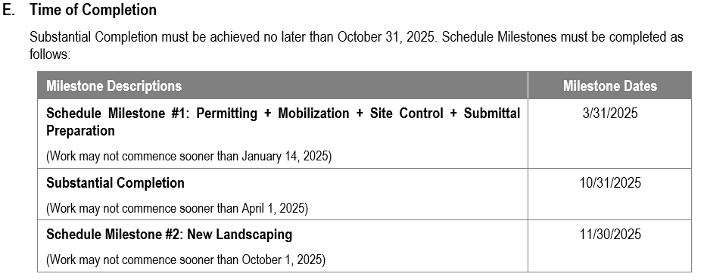
Procurement Details
PROJECT OVERVIEW
Time of Completion
Liquidated Damages
$1,000.00 per day – For failure to achieve Substantial Completion
$500.00 per day - For failure to achieve milestone date(s)

Slide 11
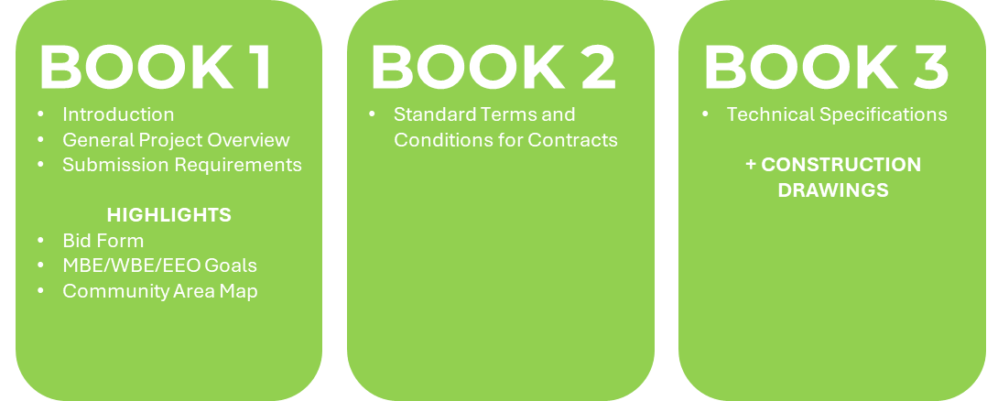
Procurement Details
AVAILABILITY OF DOCUMENTS
PBC Current Opportunities Page
https://pbcchicago.com/opportunities/cdotwpaoakley94thoakley/
Online Planroom
http://dfs.cushingco.com/pbc.htm
Printer Contact Information
Cushing and Company
213 W. Institute PIace, Suite 200
Chicago, IL 60610
Contact Name: Diane Nelson
Telephone Number: (312) 266-8228
E-Mail: dnelson@cushingco.com

Slide 12
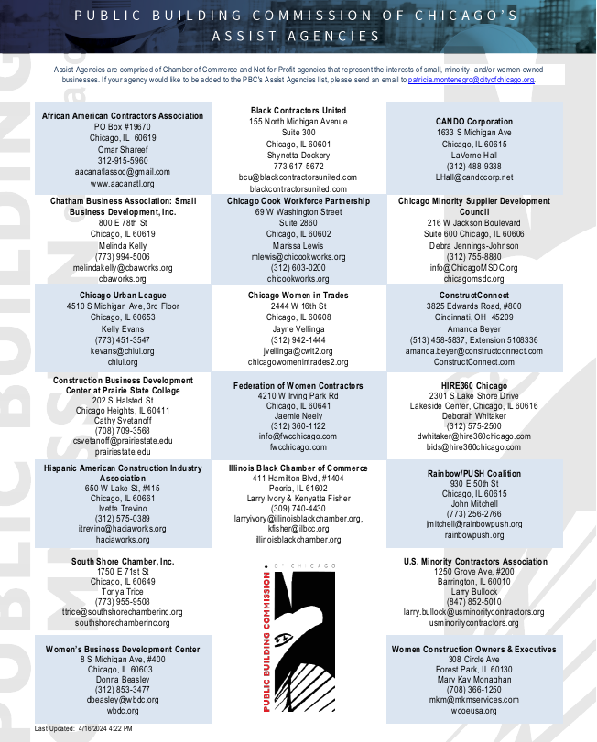
Procurement Details
AVAILABILITY OF DOCUMENTS
Assist Agencies
https://www.pbcchicago.com/doing-business/assist-agencies/

Slide 13
Procurement Details
TECH REVIEW MEETING
Date/Time
January 6, 2025 at 10:30 a.m.
(Immediately following this meeting)
SITE VISIT
None has been scheduled.
Notwithstanding
Failure of the Bidders to become familiar with the Project shall not relieve or alter the Bidder’s responsibility for completing the Work as required by the Contract Documents.

Slide 14
Procurement Details
REQUEST FOR INFORMATION (RFI’S)
Sole Point of Contact
James Borkman, Contract Officer
james.borkman@cityofchicago.org
Deadline
Current: January 10, 2025 by 4:00 p.m.
Addenda
None issued to date

Slide 15
Procurement Details
BID DUE DATE/TIME
Due Date/Time
Thursday, January 23, 2025, at 11:00 a.m.
(Subject to Change via Addendum)
Virtual Meeting Details
NOTE: The Bid Opening will be streamed LIVE and will be RECORDED and AVAILABLE on our website for viewing on PBC’s Home Page www.pbcchicago.com and on the Current Opportunity page for this project found here: https://pbcchicago.com/opportunities/cdotwpaoakley94thoakley/

Slide 16
Procurement Details
BID SUBMISSION REQUIREMENTS
Electronic Submission
One complete copy of bid document
Original Signatures (blue ink) or Digital Signature
Include Bid Bond
Include Master Bid Form (Master Bid Tab, ALL THREE Schedule of Prices, Award Criteria sheet) in EXCEL and PDF format separately within email
    NOTE: The pdf documents should be searchable PDF form and not a scanned copy.
Email to: james.borkman@cityofchicago.org AND pbc-procurement@cityofchicago.org
If Hardcopy Submission Needed
Bidders who are unable to submit their bids electronically may request instruction for submitting a “hard copy” of their bid in writing to the Director of Procurement: James Borkman at: james.borkman@cityofchiago.org

Slide 17
Procurement Details
PRE-AWARD MEETING
Date/Time
Monday, January 28, 2025 at 10:30 a.m. (Virtual)
(Subject to Change via Addendum)
NOTICE OF AWARD
Anticipated Schedule
Anticipated release of the Notice of Award (NOA) is February 2025 following the PBC Board of Commissioners Meeting
Successful General Contractor will be required to provide compliant Certificate of Insurance and Payment and Performance Bond within 7 days of NOA issuance

Slide 18
Book 1 & 2 Highlights

Slide 19
Highlights
Budget, Staffing, and Additional Requirements
Estimated Construction Budget (Book 1, Page 4) – $8,000,000 - $8,500,000
Mandatory Project Staffing (Book 1, Page 5)
Scheduling Software Requirements (Book 1, Page 6)
Liquidated Damages (Book 1, Page 6)
Prevailing Wage Rates (Book 1, Page 7 and Page 46)

Slide 20
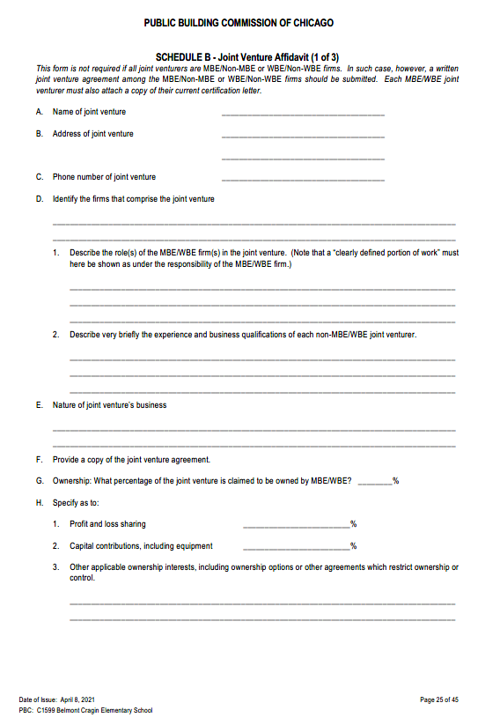
Highlights
Joint Venture Opportunities
    Schedule B – Joint Venture Affidavit
(Book 1, Page 31)
        JV Agreement
        Certification Letter

Slide 21
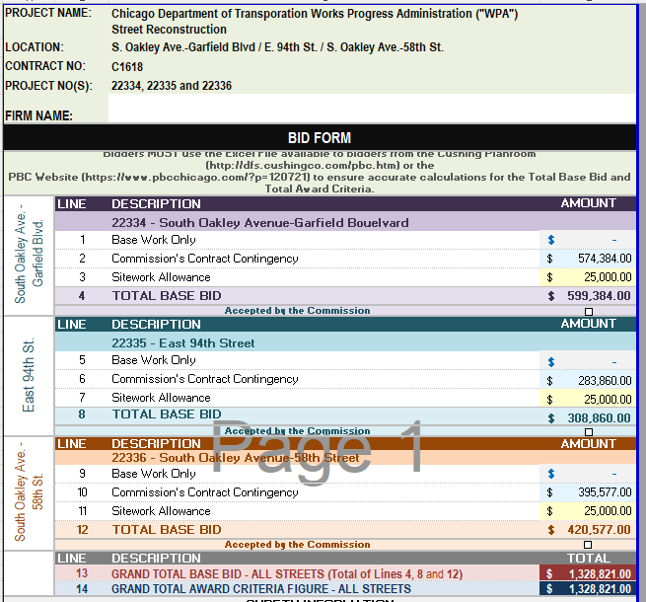
Highlights
        THE BID FORM

Slide 22
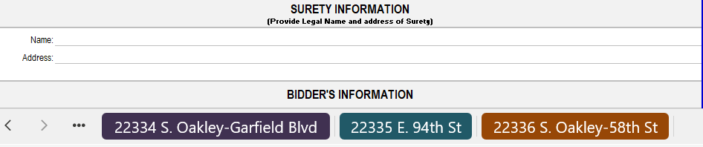
Highlights
        THE BID FORM
Each Street/Boulevard has a separate tab
(3 TOTAL)
Enter your unit pricing for THREE (3) Streets/Boulevards
The Master Bid Form will automatically populate and TOTAL

Slide 23
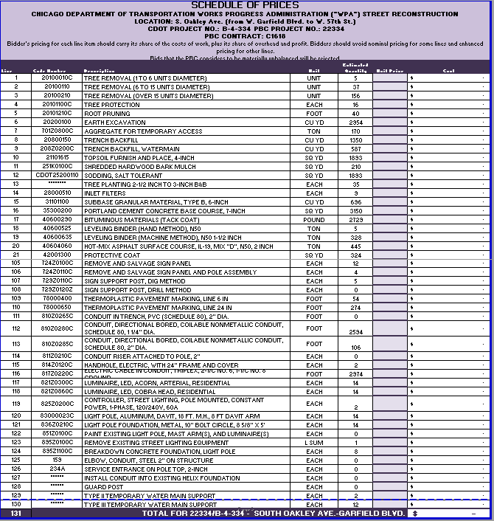
Highlights
        THE BID FORM – SCHEDULE OF PRICES
Enter your unit pricing HERE
Sheet will automatically
TOTAL HERE

Slide 24
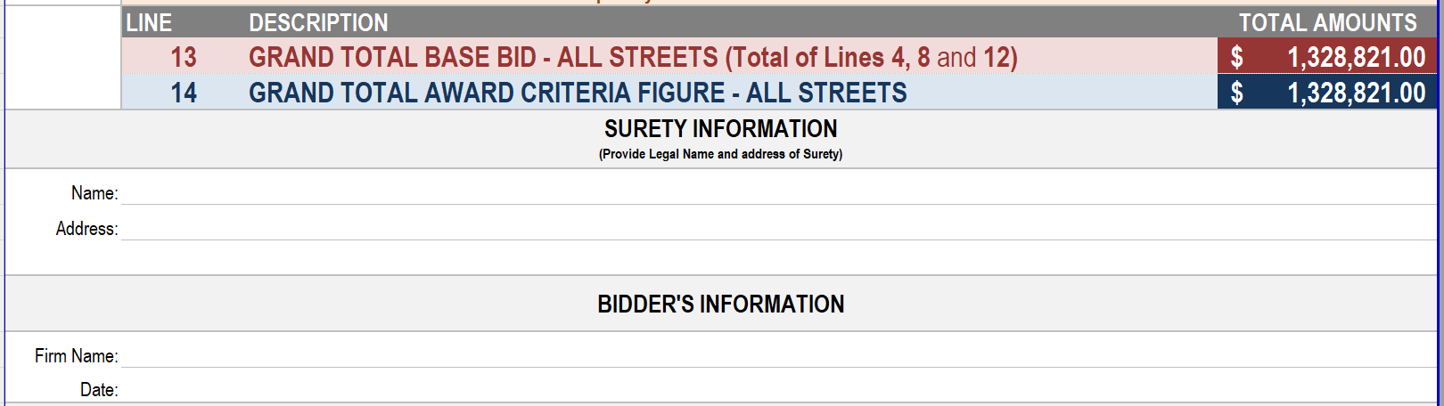



Highlights
        THE BID FORM – MASTER BID TOTAL & ADDT’L INFO
Enter your Surety & Firm Information HERE
The TOTAL from ALL streets/avenues will automatically populate HERE

Slide 25
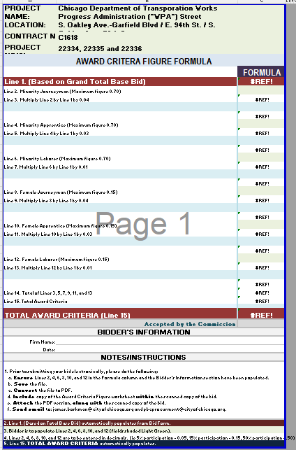
Highlights
        AWARD CRITERIA FIGURE

Slide 26
Highlights
        BASIS OF AWARD
        (Book 1, Page 10)
Award will be made to the Responsible Bidder submitting the Lowest Grand Total Award Criteria Figure (Line 14 of Bid Form) whose corresponding Grand Total Base Bid (Line 13 of Bid Form) is within the Available Funds for each street/avenue and is otherwise responsive to all requirements of the Contract Documents.
Firms are required to fill out the entire BID FORM to be considered responsive.
The Commission reserves the right to reject any and all bids wherever such rejection is in the best interest of the Commission.
Bids that the PBC considers to be materially unbalanced will be rejected.

Slide 27
Compliance

Slide 28
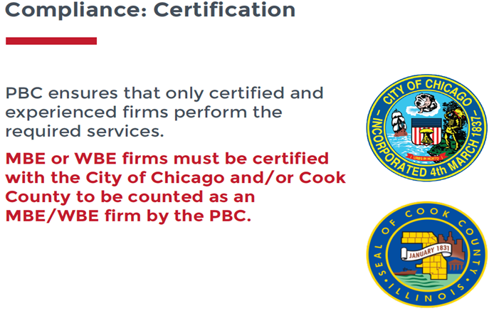
Compliance
MBE/WBE PARTICIPATION
MBE/WBE Goals
26%, MBE
6%, WBE
MBE/WBE Certifications
City of Chicago
Cook County
MBE/WBE Special Conditions
Book 2, Article 23

Slide 29
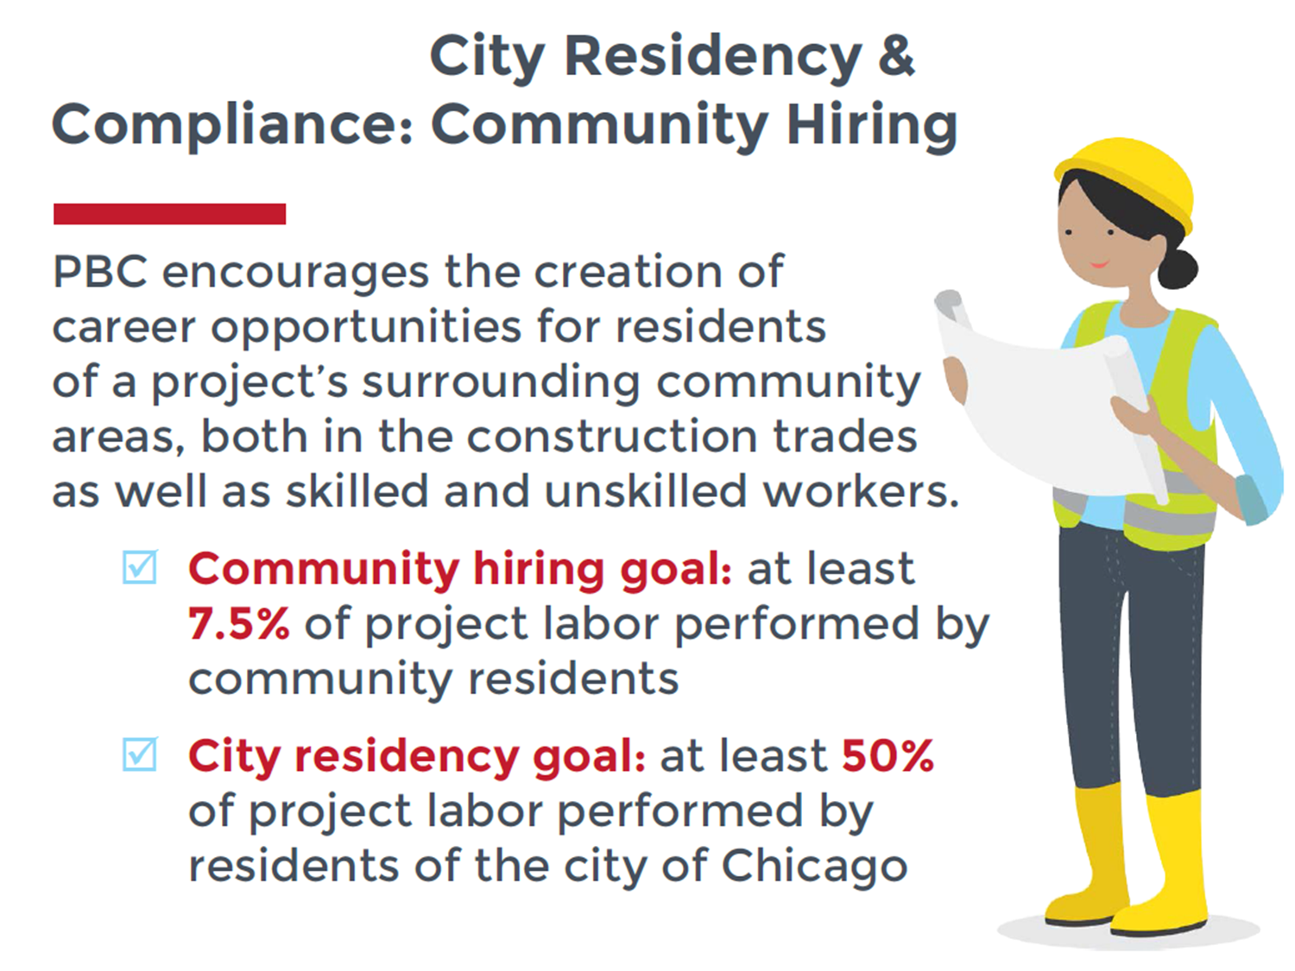
Compliance
        City Residency &
        Community Hiring
        Award Criteria Figure
        Maximum 70%
          Minority Journeyworker, Apprentice, and;
          Laborer
          Maximum 15%
          Female Journeyworker, Apprentice, and;
          Laborer

Slide 30
Compliance
        Community Hiring
        MAP

Slide 31
Compliance
MBE/WBE
COMPLIANCE
Documentation and Monitoring
B2Gnow: MBE/WBE Compliance monitoring
Established Business, Manufacturers, Suppliers, and Brokers
Schedule D
Schedule C

Slide 32
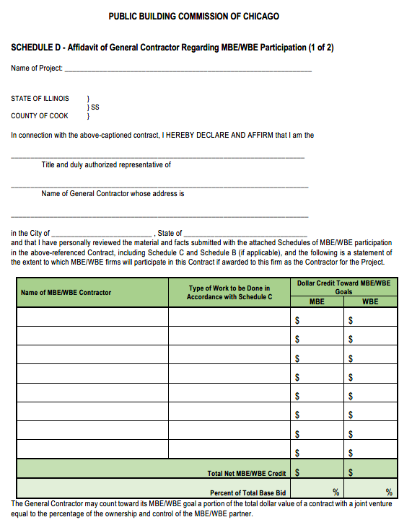
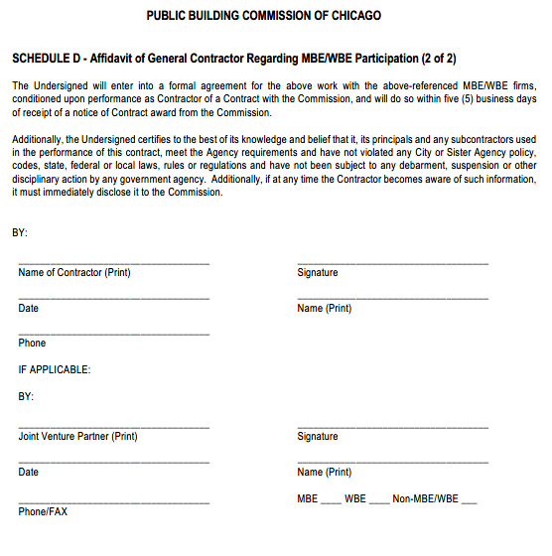
Compliance
Schedule D

Slide 33
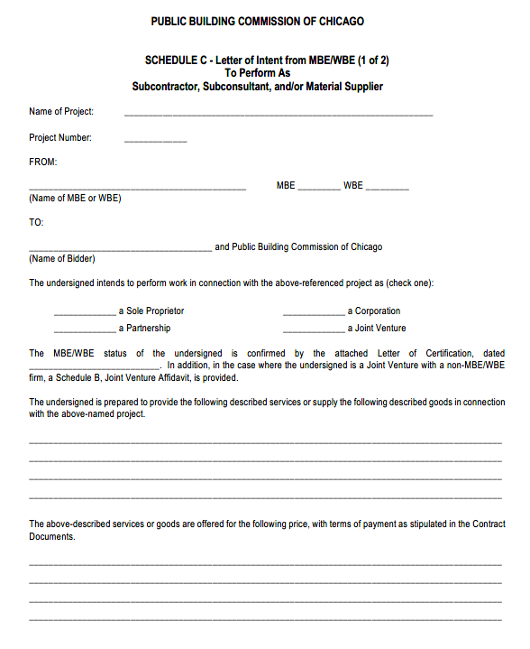
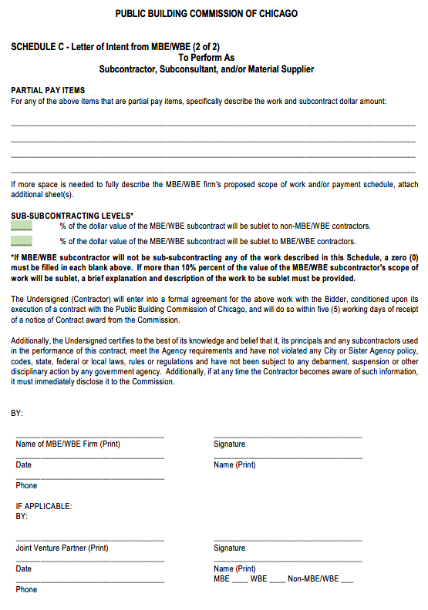
Compliance
Schedule C

Slide 34
PBC CONTACT
James Borkman
james.borkman@cityofchicago.org

Slide 35
Technical Review

Slide 36
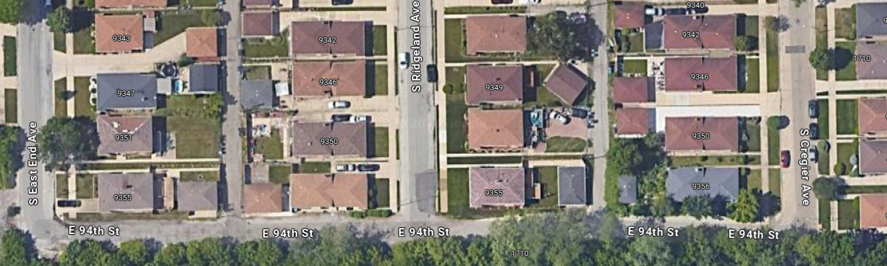
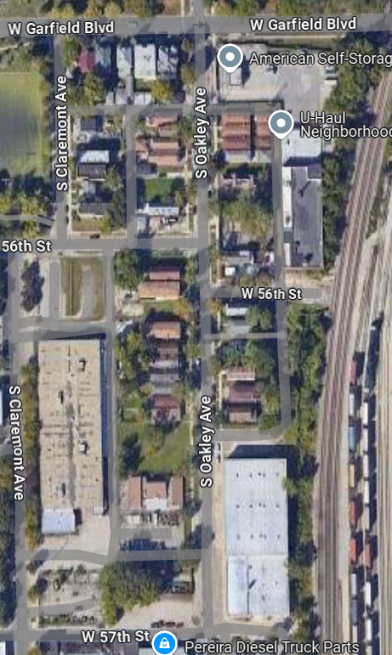
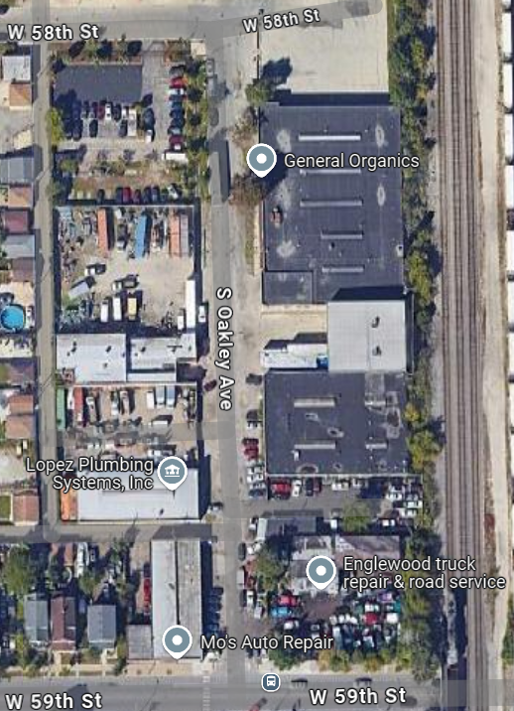
Project Overview
Project Location
E. 94th Street from S. East End Avenue to S. Cregier Ave.
S. Oakley Avenue from W. 58th Street to W. 59th Street.
S. Oakley Avenue from W. Garfield Blvd to W. 57th Street

Slide 37
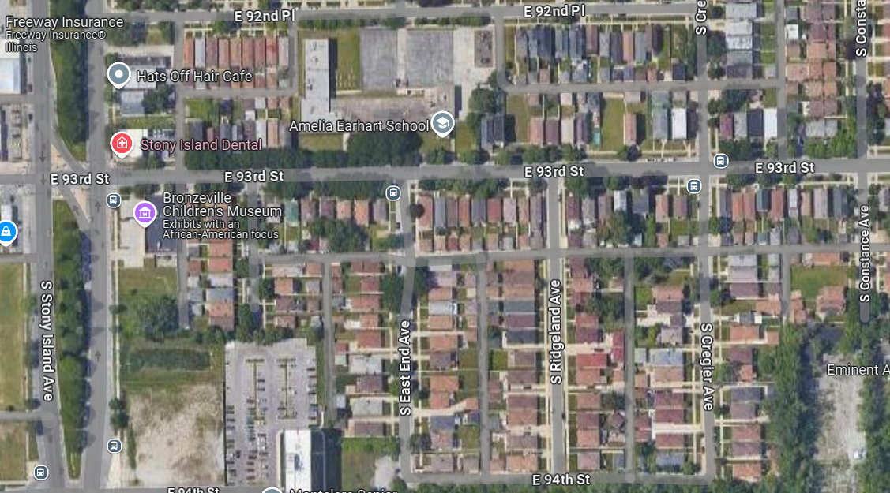
Project Overview
Project Location
E. 94th Street from S. East End Avenue to S. Cregier Ave.
Project Overview
Existing Conditions
Proposed Conditions
Local Coordination

Slide 38
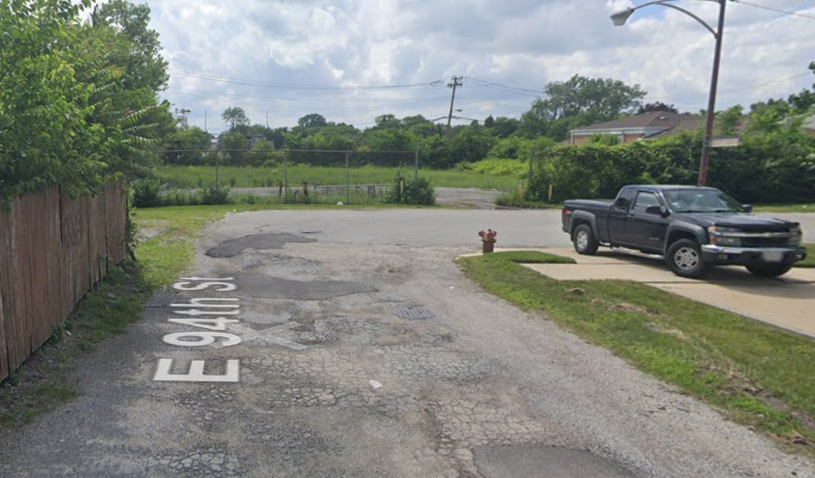
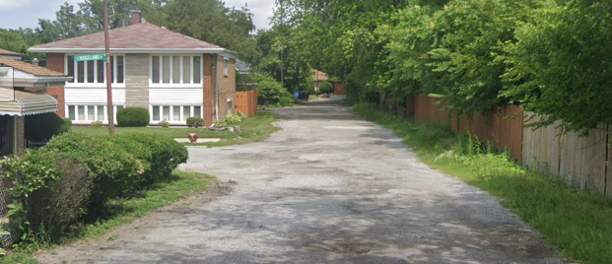
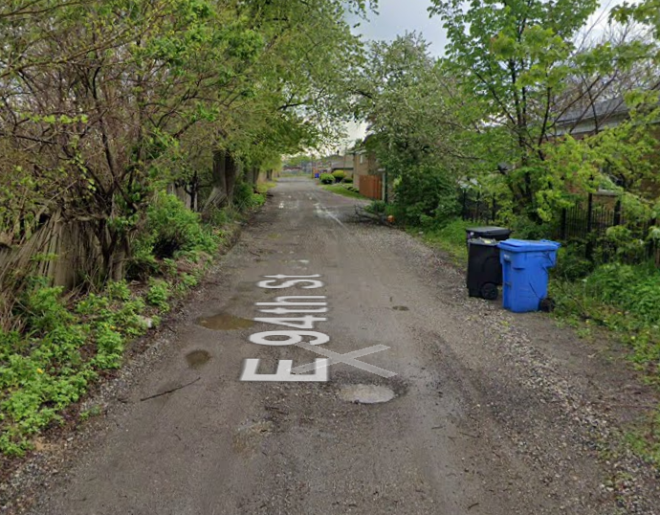
Existing Conditions
Roadway
Roadway width varies from 20-24’, ROW 33’
3 Intersections:
    S. East End Avenue
    S. Ridgeland Avenue
    S. Cregier Avenue

Slide 39
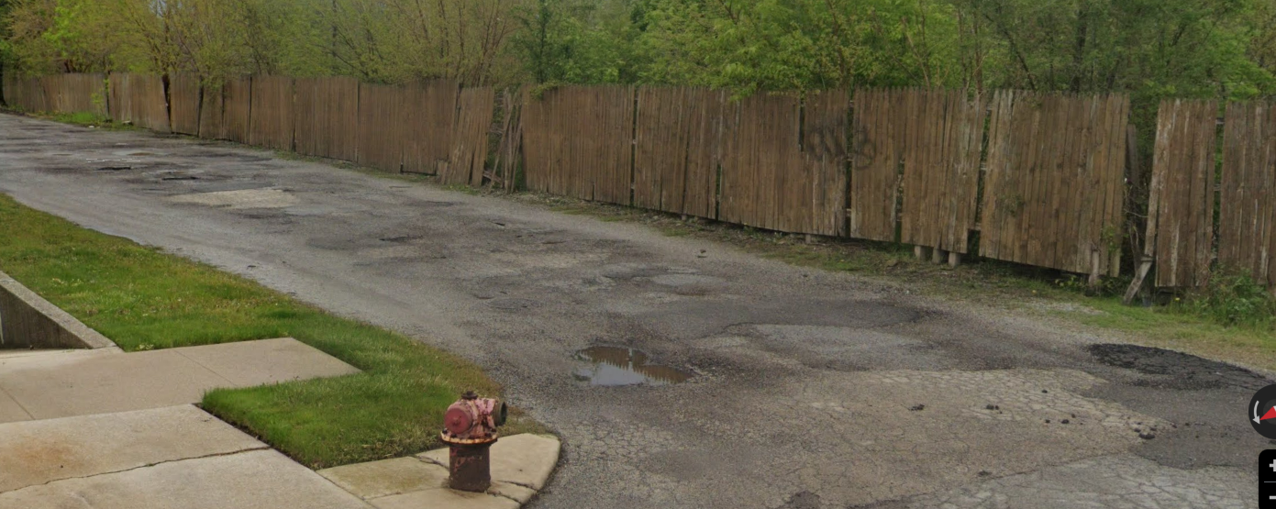
Existing Conditions
Concerns
No curb and gutter
Poor pavement condition
Lack of curb & gutter leads to flooding on the street and on private property.

Slide 40
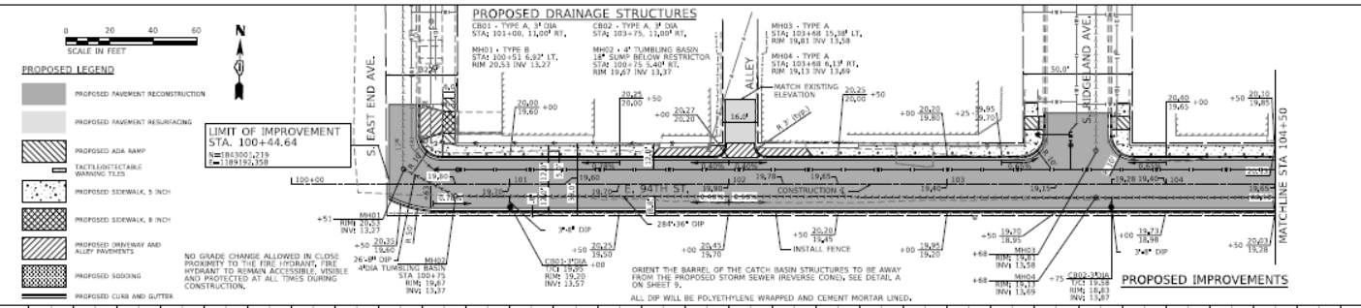
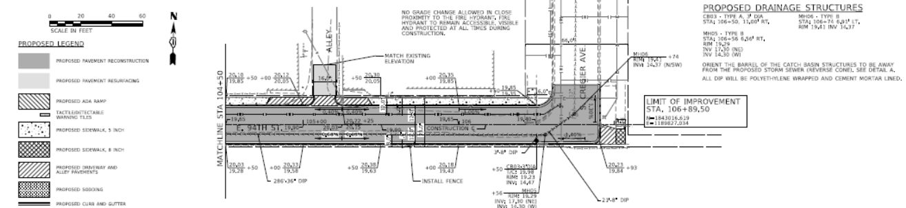
Proposed Conditions
Roadway
Install 24’ roadway with curb & gutter.
Construct new driveways and alley aprons for positive drainage.
Superelevated cross slope to drain to south side.

Slide 41
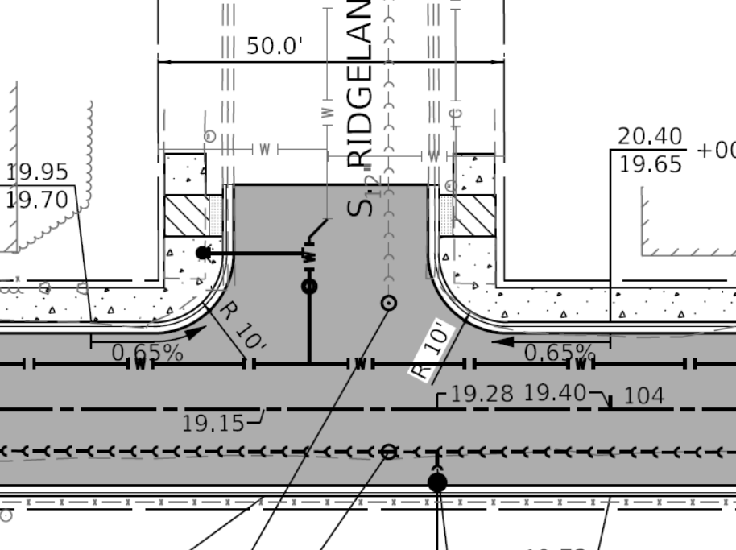
Proposed Conditions
Sidewalk
Install new sidewalk on the north side of 94th Street between S. East End Ave and S. Cregier Ave.
Install new ADA ramps at Ridgeland Ave.

Slide 42
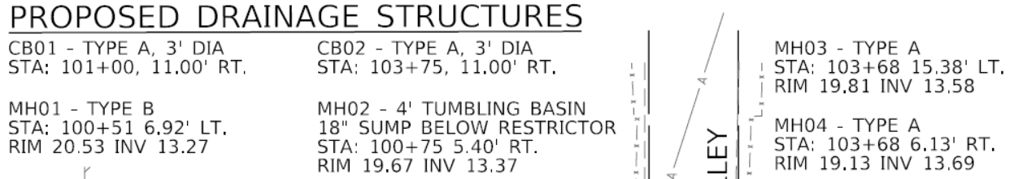
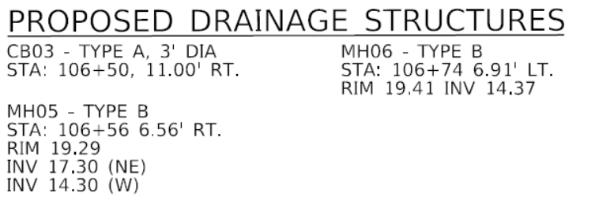
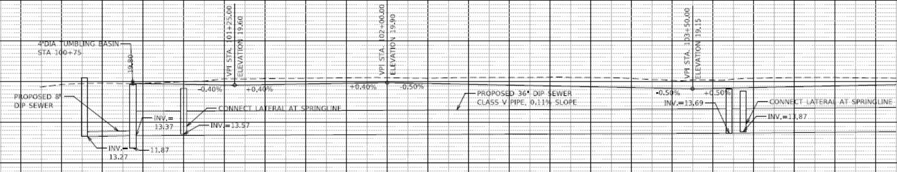
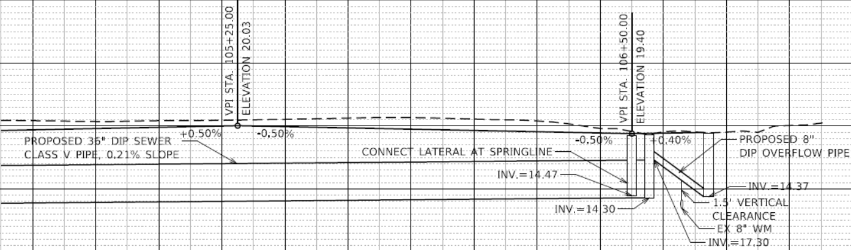
Proposed Conditions
Detention
Install new 36” DIP storm sewer per plans.
Make connections at S East End Ave. and S. Cregier Ave.
Install 3 catch basins on south.
Install 6 manholes.

Slide 43
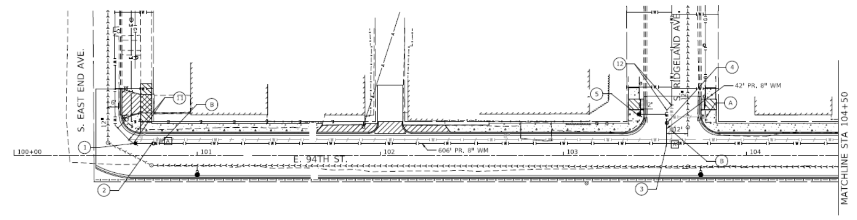
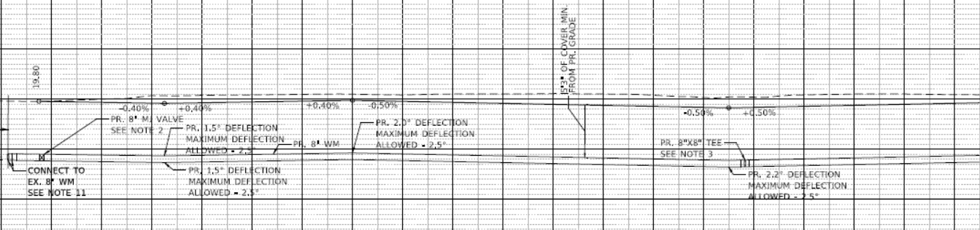
Proposed Conditions
Water Main
Install 8” DI main per plans.
No service lines.
New Hydrant at S. Ridgeland Ave.

Slide 44
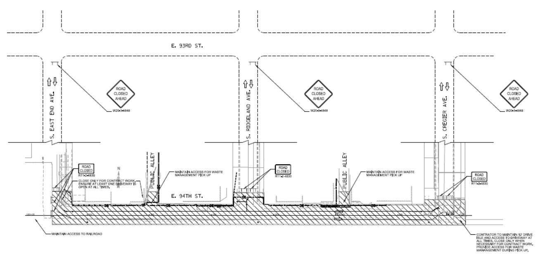
Proposed Conditions
Maintenance of Traffic
One Stage
Full Closure

Slide 45
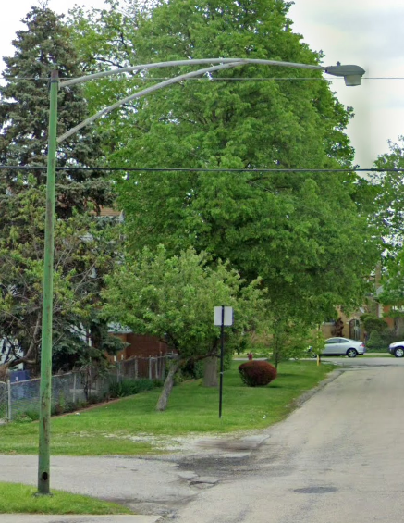
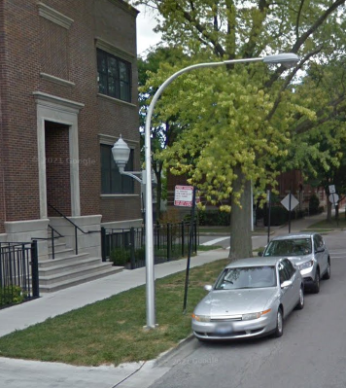
Proposed Conditions
Lighting
Install new street lighting which includes piggyback lighting for pedestrians
  One light pole provides lighting for both the street and sidewalk
Upgraded LED lamps
Cobra Head for street luminaire.
Acorn Head for the pedestrian luminaire.

Slide 46
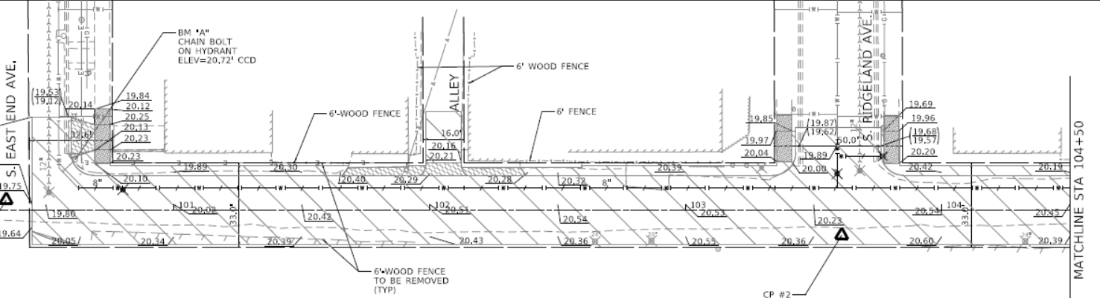
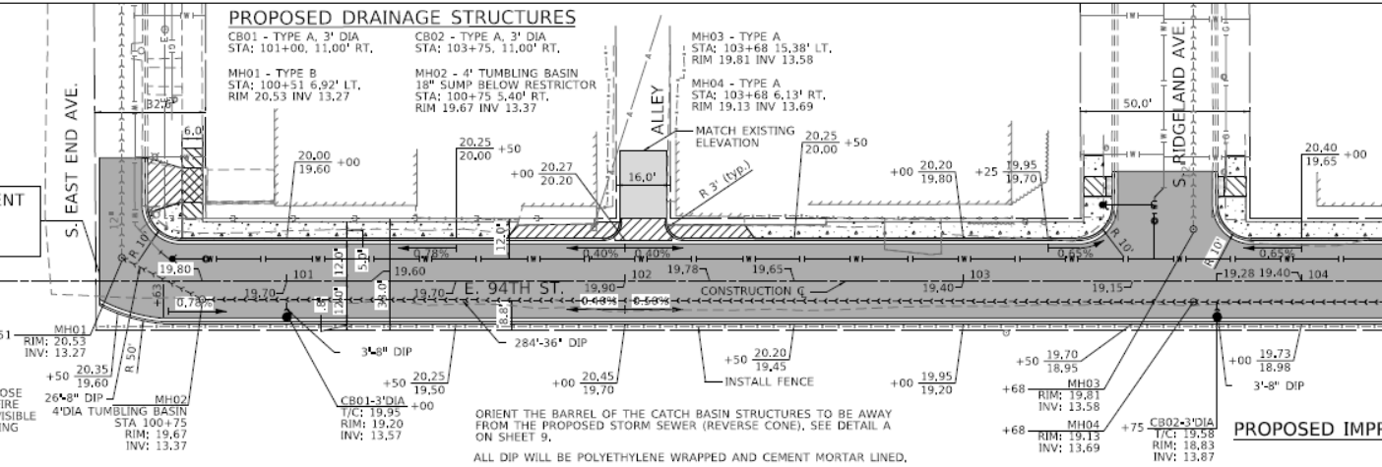
Proposed Conditions
Landscaping
Existing trees to be removed as shown on plans, vary in size from under 6” to 24”.
No Tree plantings.
New grass sod to be placed on south side of 94th between the curb and ROW.

Slide 47
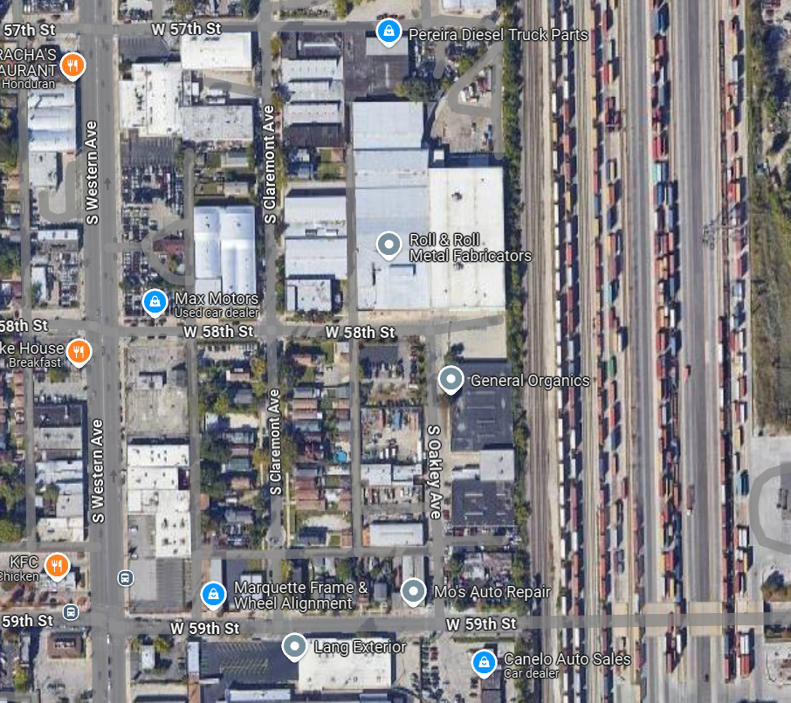
Project Overview
Project Location
S. Oakley Avenue from W. 58th Street to W. 59th Street.
W 58th Street
Project Overview
Existing Conditions
Proposed Conditions
Local Coordination
S Oakley Ave
S Western Ave
W 59th Street

Slide 48
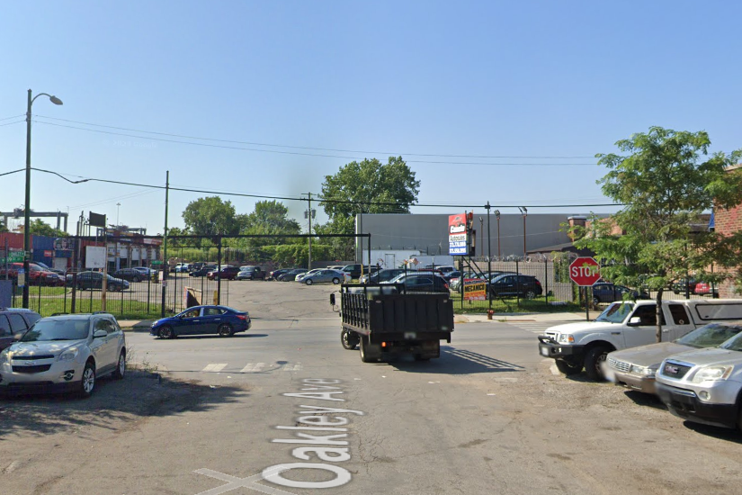
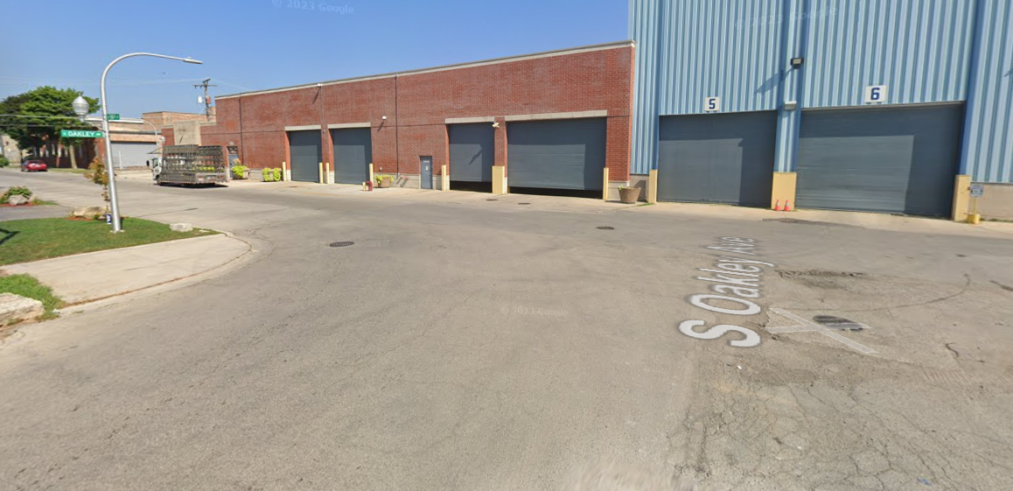
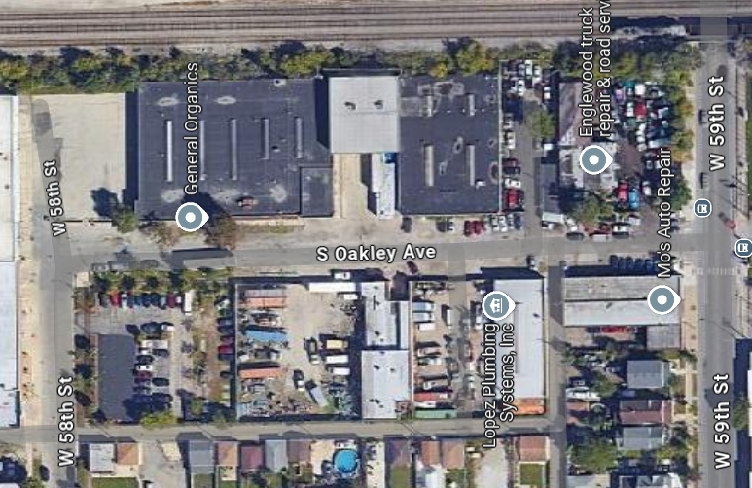
Existing Conditions
Roadway
Roadway width varies from 28’-31’
2 Intersections:
    W 58th Street
    W 59th Street

Slide 49
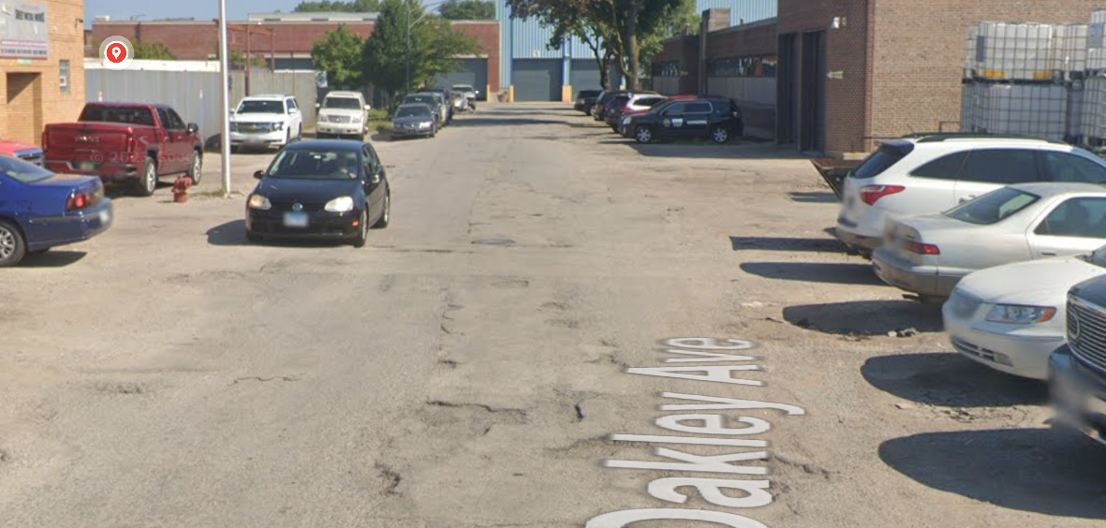
Existing Conditions
Concerns
Poor pavement condition
Lack of curb & gutter leads to flooding on the street and on private property.

Slide 50
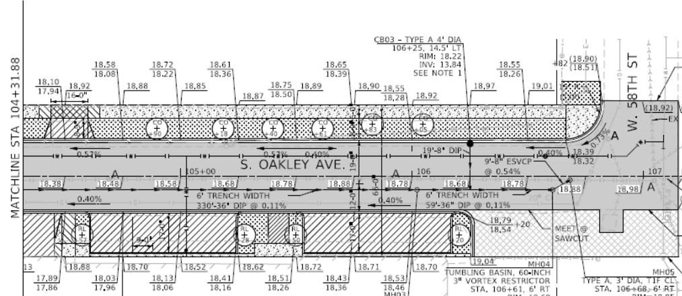
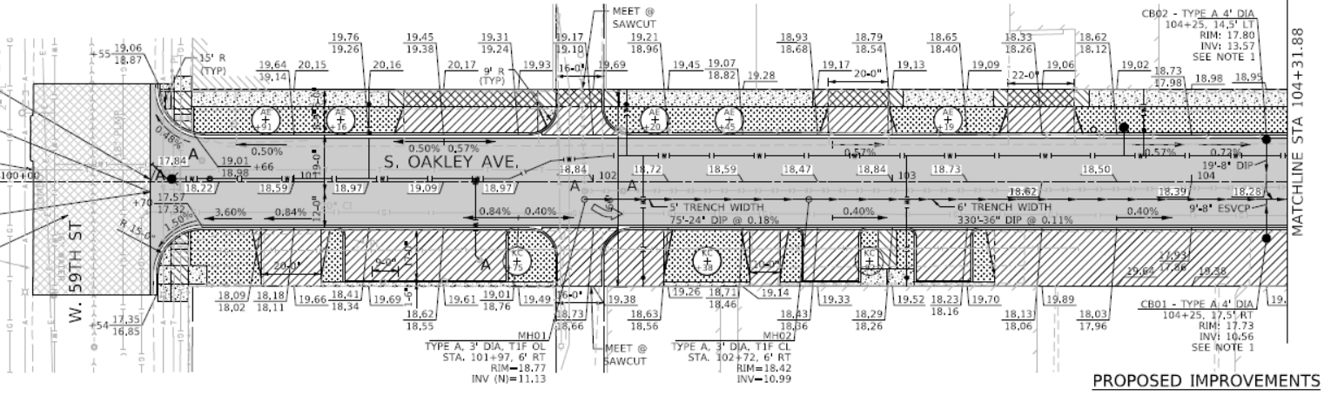
Proposed Conditions
Roadway
Install 31’ width and curb & gutter.
Reconstruct the driveways and alley aprons.

Slide 51
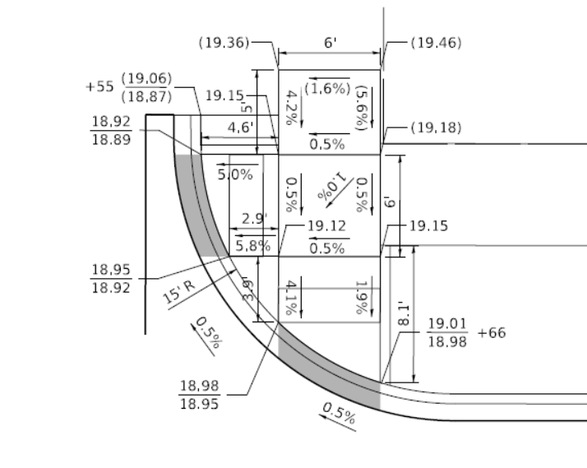
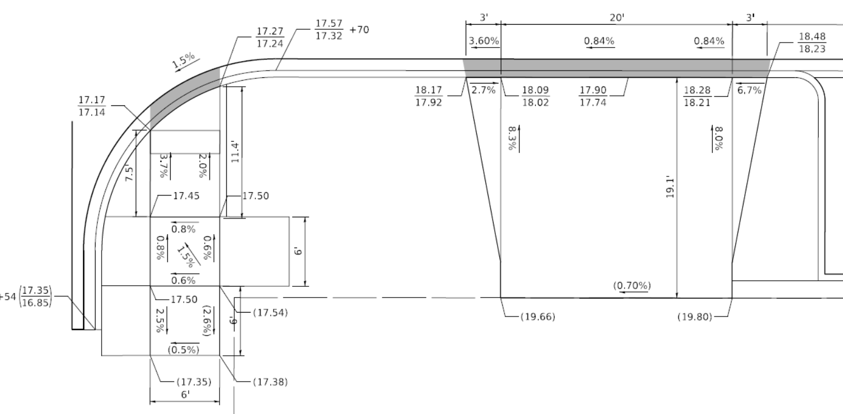
Proposed Conditions
Sidewalk
Install new sidewalk on the West side of S. Oakley Ave. between W 58th Street and W 59th Street.
Install ADA ramps at W 59th Street.

Slide 52
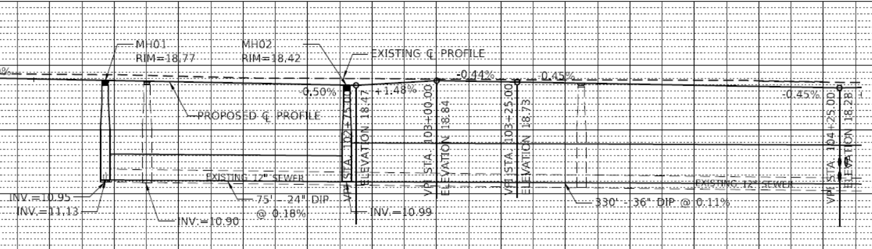
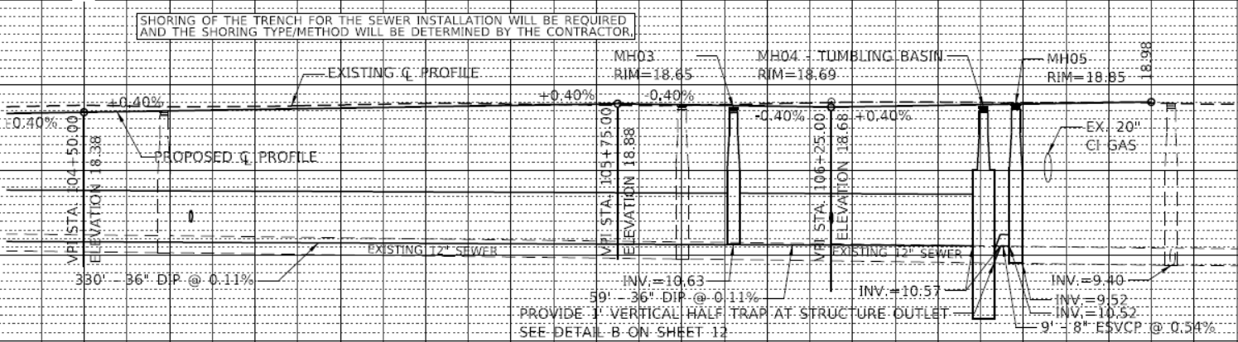
Proposed Conditions
Detention
Install new 24” and 36” DI storm sewers.
Install 5 manholes and 3 catch basins.

Slide 53
Proposed Conditions
Water Main
Install new 8” DI water main.
7 Lead Service lines.
1 Fire hydrant

Slide 54
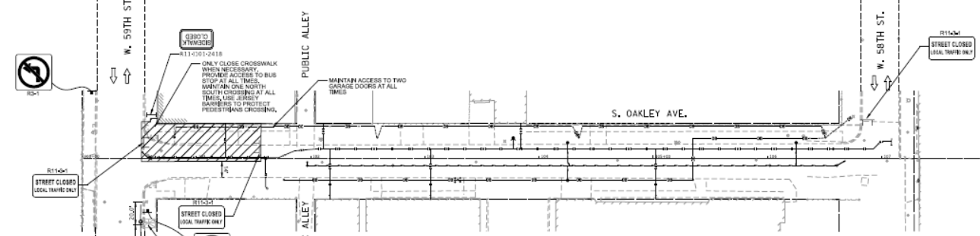


Proposed Conditions
Maintenance of Traffic
Stage 1
Stage 2
Stage 3

Slide 55
Proposed Conditions
Lighting
Install new street lighting which includes piggyback lighting for pedestrians
  One light pole provides lighting for both the street and sidewalk
Upgraded LED lamps
Cobra Head for street luminaire.
Acorn Head for the pedestrian luminaire.

Slide 56


Proposed Conditions
Landscaping
Existing trees planned to be removed as shown on plans
18 new trees to be planted between the sidewalk and roadway
New grass sod to be placed

Slide 57

Project Overview
Project Location
W Garfield Blvd
S. Oakley Avenue from Garfield Blvd to W. 57th Street
W 56th St
Project Overview
Existing Conditions
Proposed Conditions
Local Coordination
S Claremont Ave
S Oakley Ave

Slide 58



Existing Conditions
Roadway
Roadway width varies from 25-28’
2 Intersections:
    W 56th Street
    W Garfield Blvd.

Slide 59

Existing Conditions
Concerns
Poor pavement condition
Lack of curb & gutter leads to flooding on the street and on private property.

Slide 60



Proposed Conditions
Roadway
Widen roadway to 30’ width and install the curb & gutter.
Construct new driveways and alley aprons.

Slide 61



Proposed Conditions
Sidewalk
Install new sidewalks at various locations as shown on the plans.
Install ADA ramps at W 56th Street.

Slide 62

Proposed Conditions
Sewer
Remove existing 12” sewer
Install 24” RCP mainline sewer per plans.
Install 4 manholes, 9 catch basins, 4 inlets.

Slide 63


Proposed Conditions
Water Main
Install 8” DI water main.
Abandon existing main.
29 Lead Service Lines.
Install 1 Fire Hydrant.

Slide 64






Proposed Conditions
Maintenance of Traffic
Stage 1
Stage 2
Stage 3

Slide 65

Proposed Conditions
Landscaping
Existing trees to be removed per plans.
35 new trees to be planted between the sidewalk and roadway.
New topsoil and sod to be placed.

Slide 66
Proposed Conditions (cont)
Lighting
Install new street lighting which includes piggyback lighting for pedestrians
  One light pole provides lighting for both the street and sidewalk
Upgraded LED lamps
Cobra Head for street luminaire.
Acorn Head for the pedestrian luminaire.

Slide 67
Q&A

